Slide 1
YOUTH FOR THE RHINE
Alessandro Caretto

Slide 2
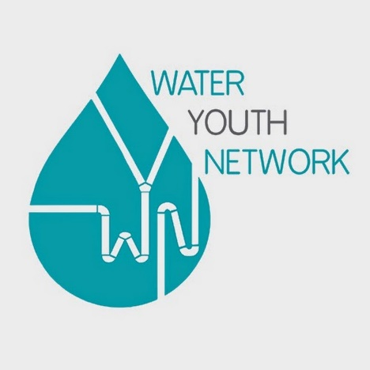
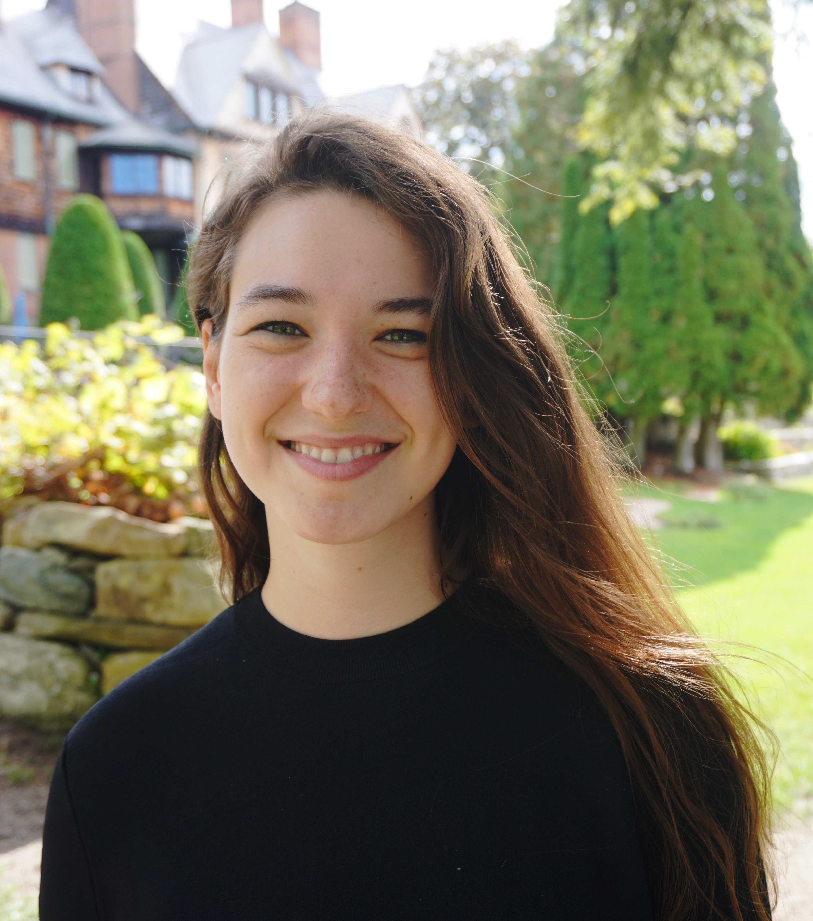
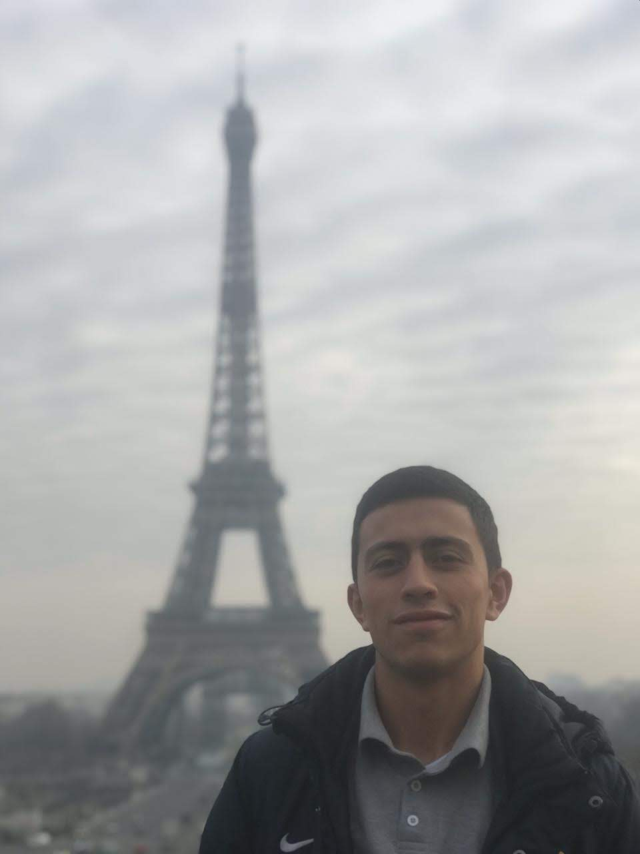
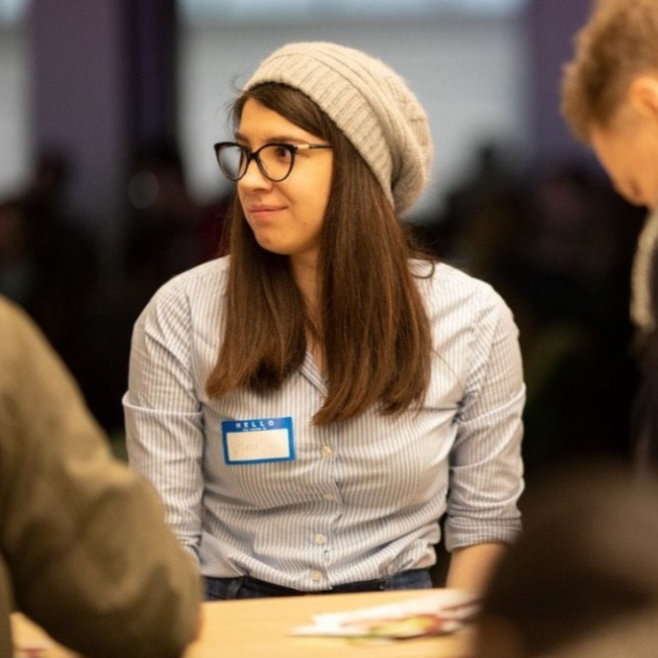
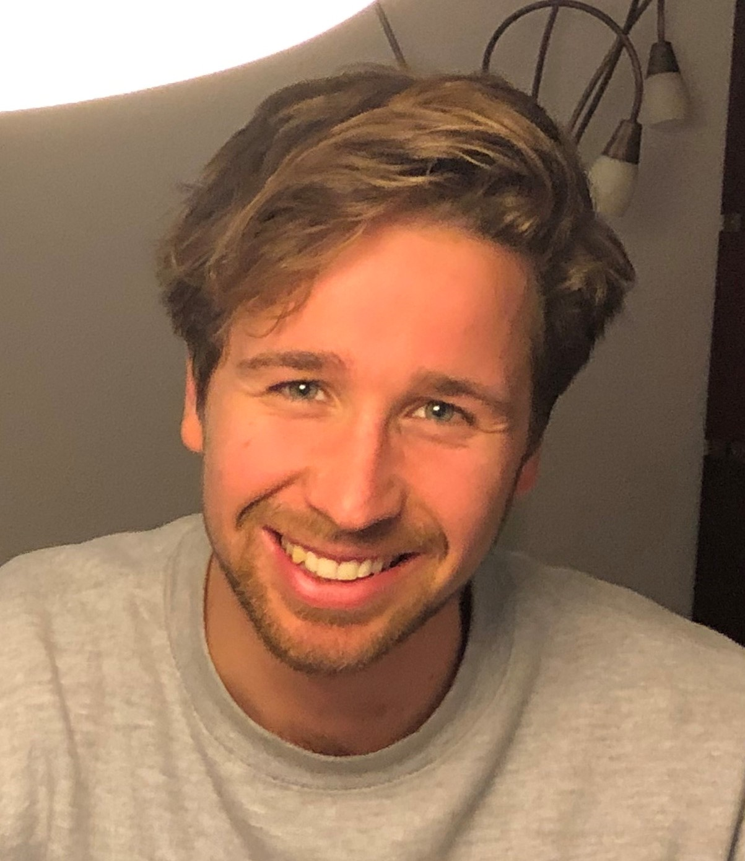
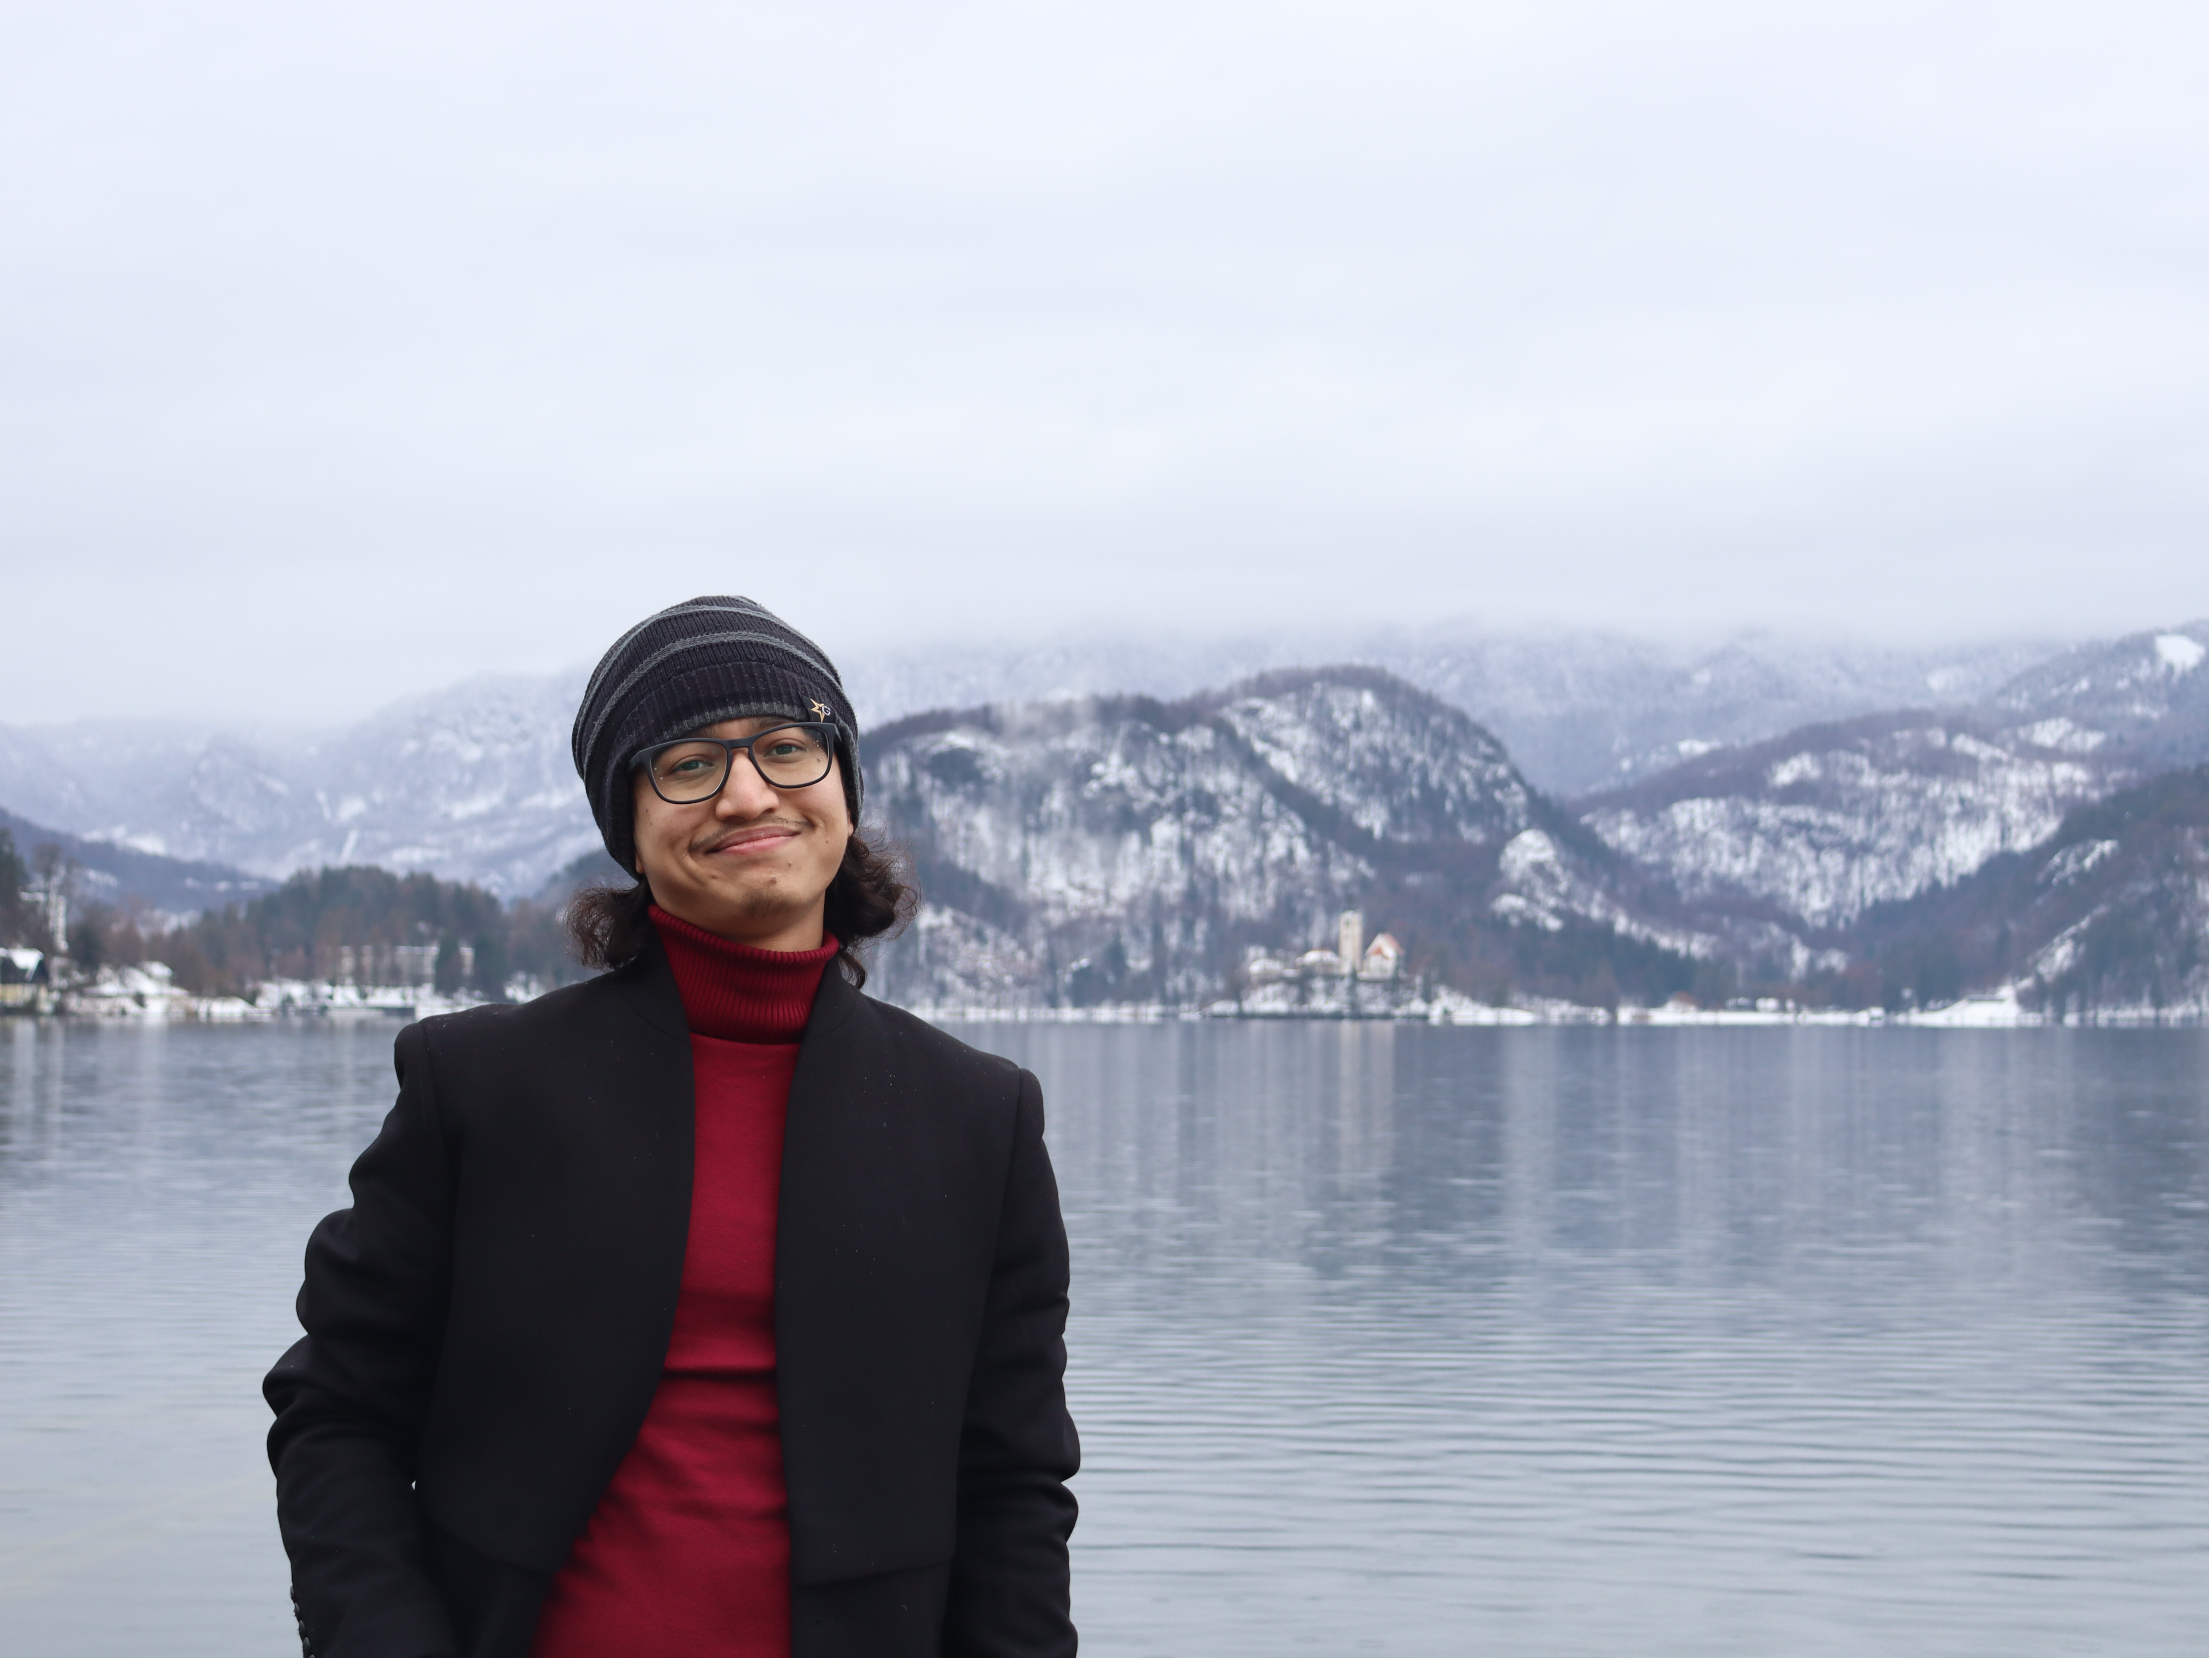
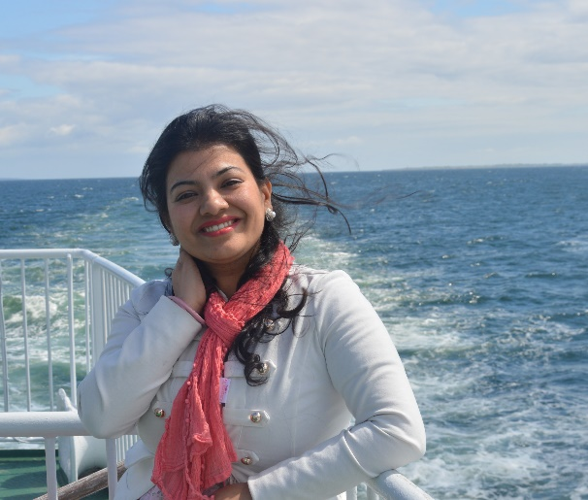
What is Youth for the Rhine?
The initial idea for the project was developed by the Foundation Physics of Cooperation and Rijkswaterstaat
The project is coordinated by IHE Delft, with over 90 members aged between 18-35, spread across the globe
2

Slide 3
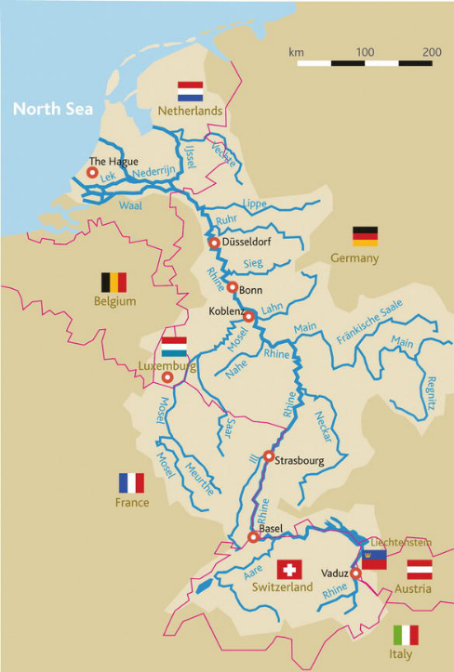
What is Youth for the Rhine?
A transboundary youth-led initiative to connect young, multidisciplinary professionals and students throughout the Rhine Basin to co-create ideas for sustainable environmental actions and climate adaptation
A knowledge sharing and collaborative network connecting students and research institutions across the Rhine Basin
Aims to inspire the international Rhine committees, the European Commission, and local authorities with new, multidisciplinary perspectives

Slide 4
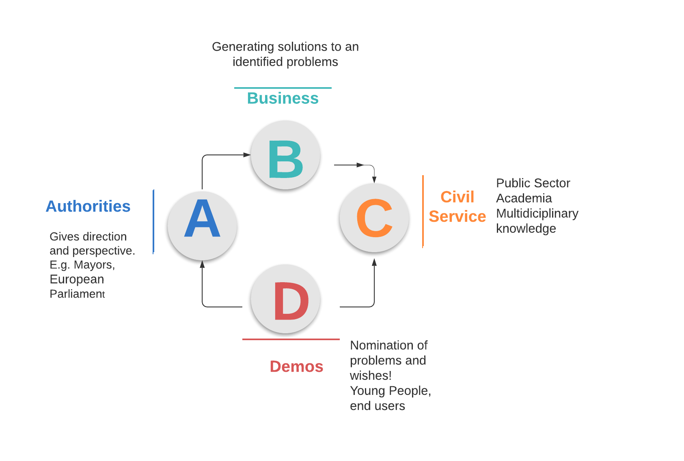
Climate innovation through co-creation
When faced with societal challenges, all four basic societal energies A, B, C and D are present – with a fusion of their contributions - the outcome will be concrete innovations with societal impact.
In ‘Youth for the Rhine’, our work starts with the ‘D’ - young end-users of the water system. We connect them with each other and the ‘ABC’ counterparts
With the members of Youth for the Rhine, we discuss and tackle a variety of social and environmental issues in the Rhine Basin
4

Slide 5
Organisational Structure
Operations Committees
Support Committees
1
Implementation
3
Fundraising & Partnerships
Organise concrete actions (research, awareness raising etc.) on pressing issues identified by youth in the Rhine Basin
Secure long-term project financing. Build partnerships with external private and public institutions.
2
Youth Consultation
4
Communications & Outreach
Gather youth voices from the Rhine Basin on pressing issues. To be translated into local and regional policy dialogues.
Amplify the voice of the project through social media, webinars, blogs & articles.
Project Management
Support for Committees in day-to-day management. Project planning & strategy. Hosted by IHE Delft.
RIJKSWATERSTAAT (RWS)

Slide 6
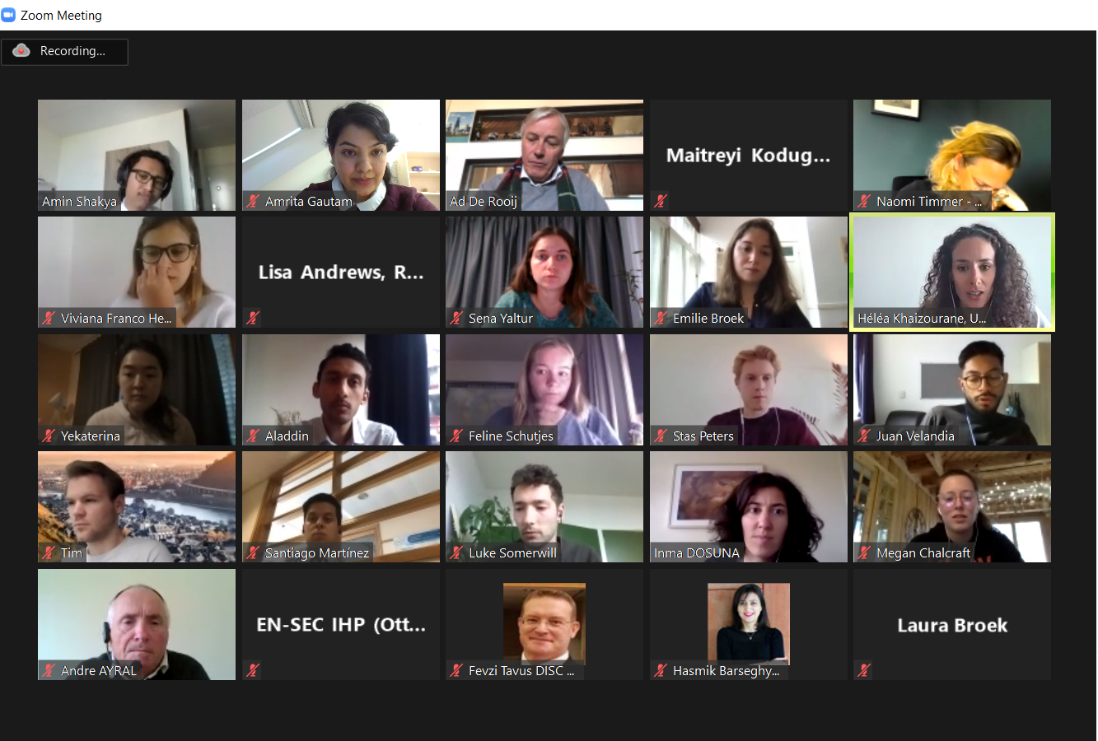
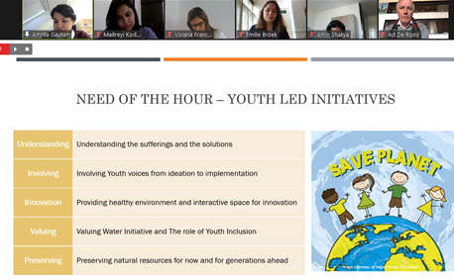
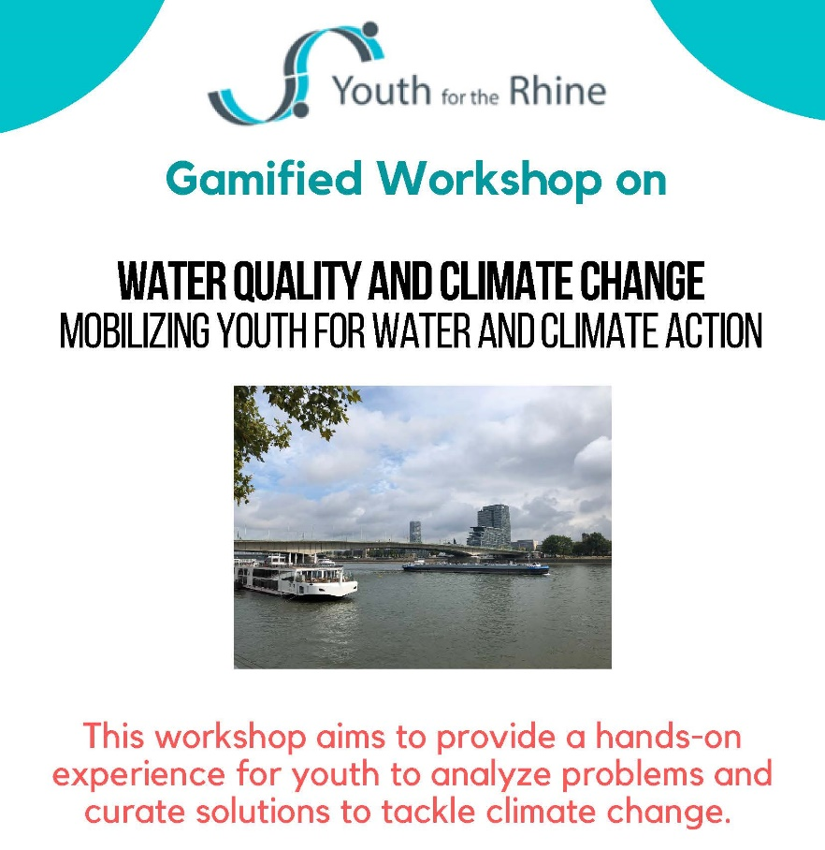
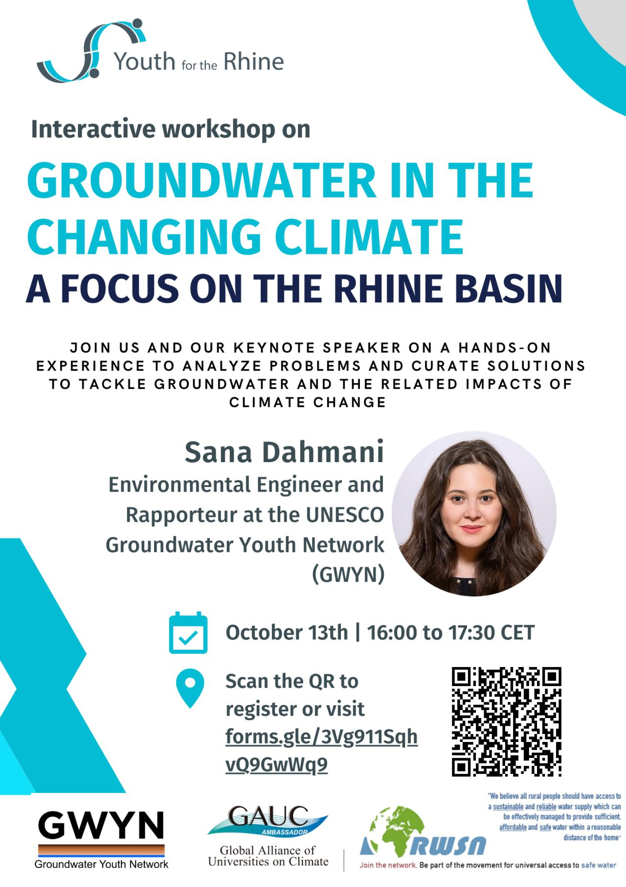
The Online Youth Consultation
Connect youth across the Rhine Basin and empower them to identify their priorities and views on issues related to climate change and the Water-Food-Energy nexus
Activities:
Host different activities targeting young people in the Rhine Basin to collect their perceptions
Work through the ABCD Model of co-creation, to engage various stakeholders in the discussion between the different components of the model
Building towards future activities and youth consultations in the next phases of the project

Slide 7
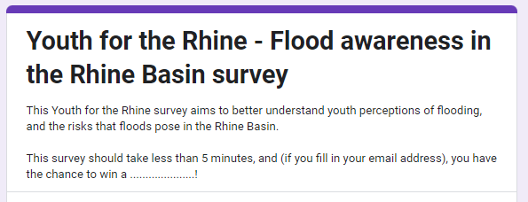
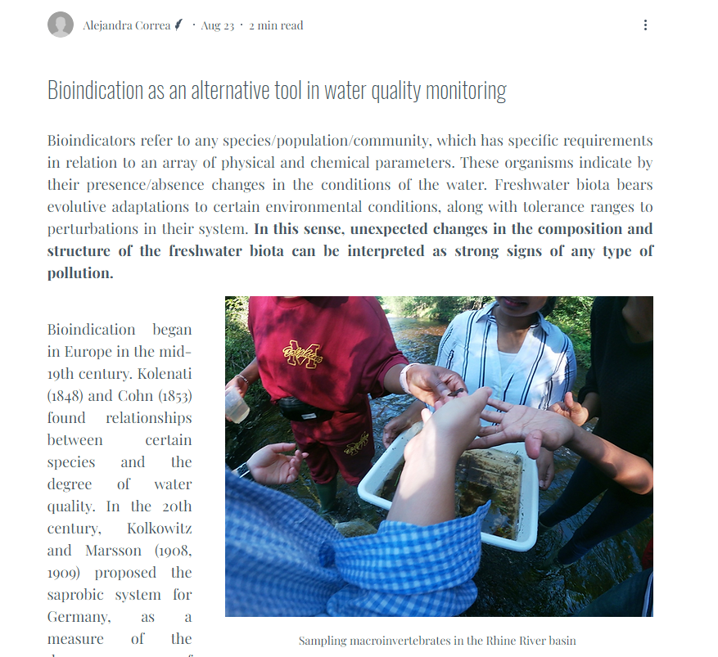
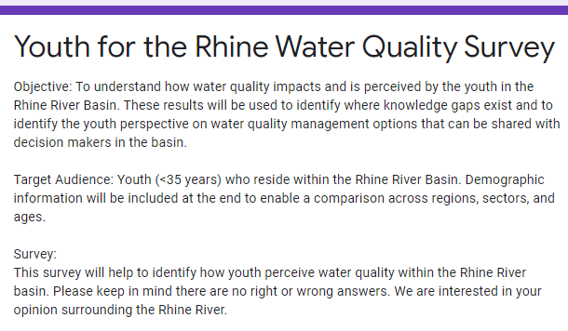
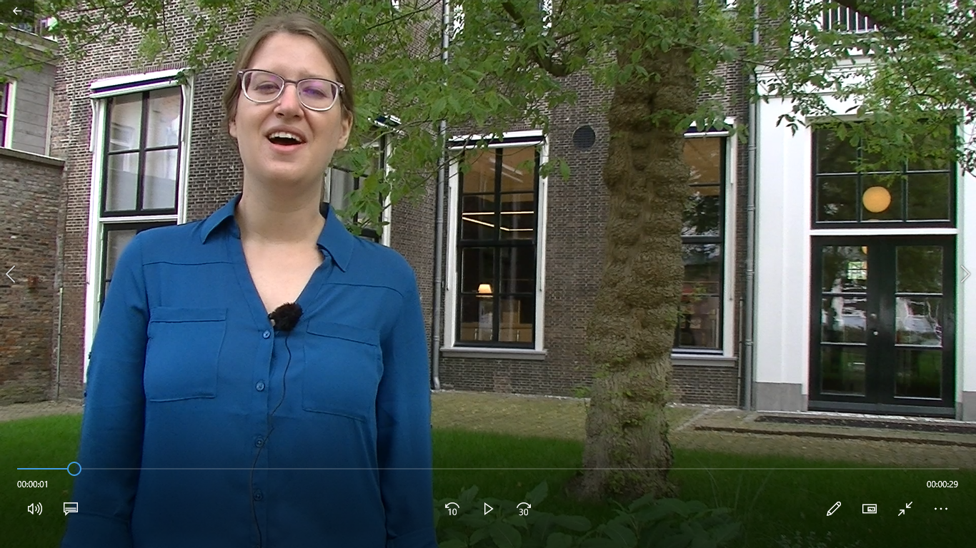
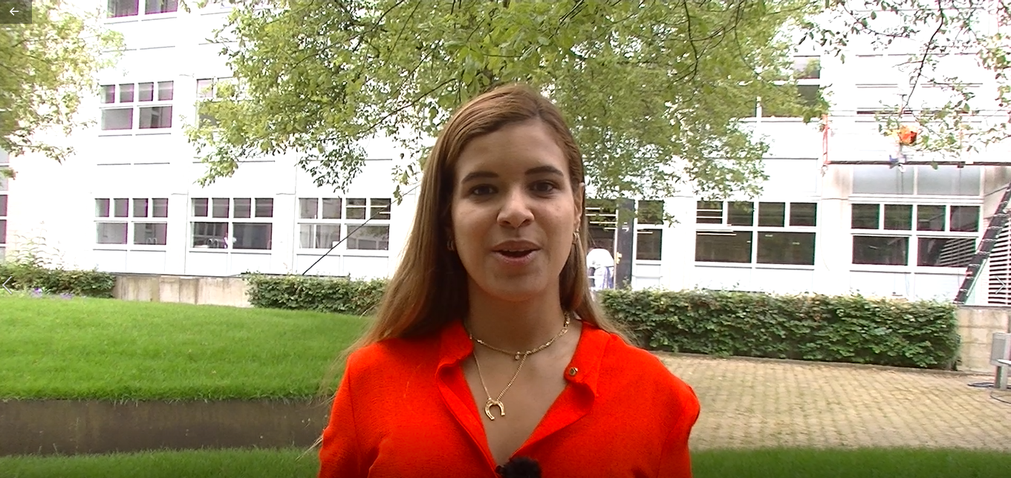
Implementation
Organise research and activities based on key social and environmental issues identified by youth
Promote multidisciplinary knowledge to address issues and elevate the voices of youth
Distribution of a surveys to gather data on the perspectives and behavior of youth in the Basin
Supplemental data collection
Blog writing
Educational outreach campaigns

Slide 8
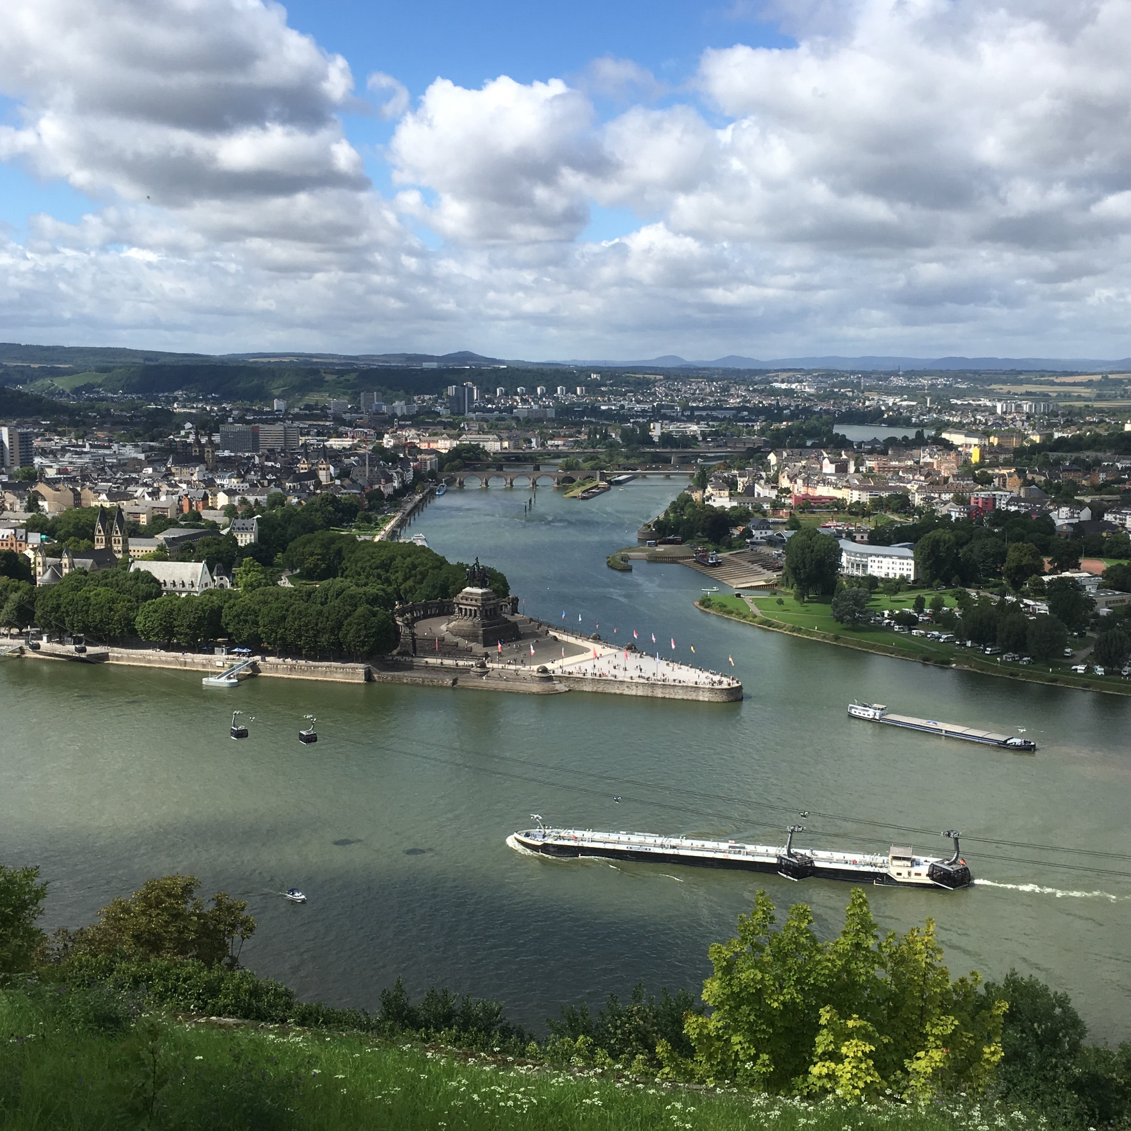
How can you get involved in youth for the rhine?
We aim to develop a stable network of knowledge institutions, students, young professionals and PhDs in the Rhine Basin, to network, collaborate, showcase their work and provide support to them in their research activities.
Would you like to get involved by:
Connecting with the network yourself?
Connecting the network with universities or research institutes along the Rhine?
Offering other types of scientific support to the network?

Slide 9
How can you get involved in youth for the rhine?
Would you like to get involved by:
Connecting with the network yourself?
Connecting the network with universities or research institutes along the Rhine?
Offering other types of scientific support to the network?
Get in touch with us via this Google Form: https://forms.gle/1BH7aoqDd15mBGmX9
…or email us at youthfortherhine@gmail.com
9

Slide 10
THANK YOU
And have a nice summit!

