Slide 1
Youth in EU advocacy – political and legal activism for rivers
Giulia Testa - GYBN Europe, GCE, Young Rewilders

Slide 4
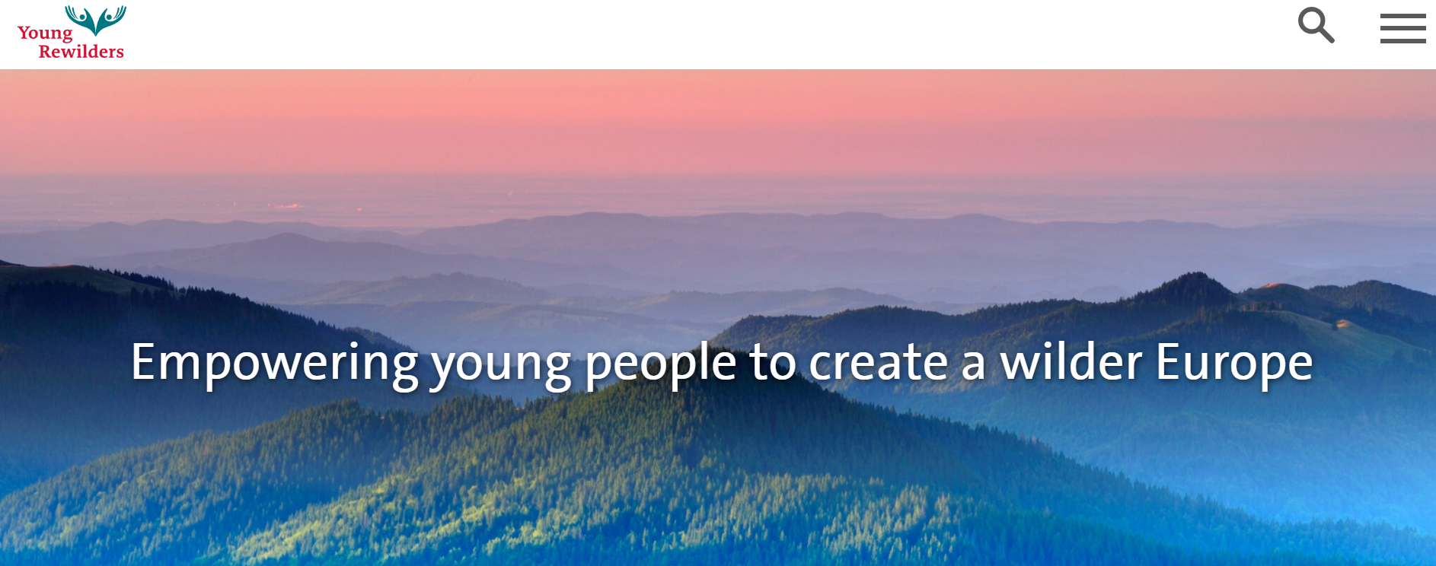
Coming soon…
Partnership with Dam Removal Europe
Rewilding Oder Delta - Ina, Gowieniza, Ueker, Peene rivers
Rewilding Danube Delta - Ukraine
Rewilding Sweden - Abrahamson and Pite rivers
Work on peatlands (Scotland, Sweden, Poland, Germany) with Wetlands International

Slide 5
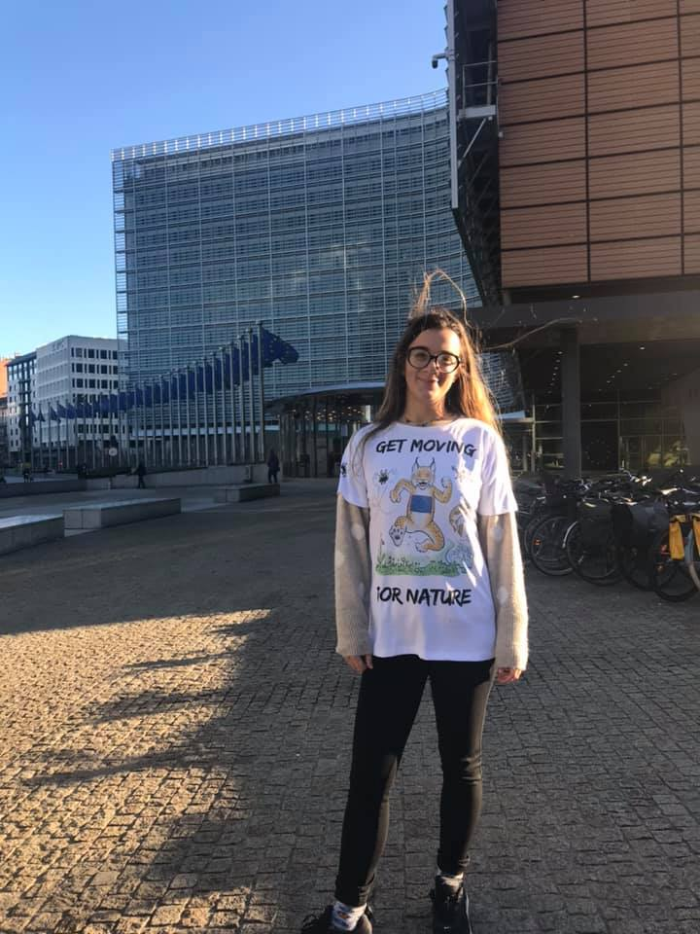
HOW DOES THIS ACTIVISM LOOK LIKE?

Slide 6
HOW DOES THIS ACTIVISM LOOK LIKE?
Inclusive and enforceable monitoring and governance framework at EU and CBD levels.
Comprehensive ecosystem-based management approach that integrates all stressors in all River Basin Management Plans to achieve the WFD’s objectives during the 2022-2027 cycle.
Mosaic funding model that includes private sector funding through the polluter pays principle.
Initiation of other projects aimed at restoring ecosystem services;
Collaborative governance and (youth) inclusive decision-making approach to river management.
Intensify the measures to fight plastic pollution.
Considering rights to rivers.

Slide 7
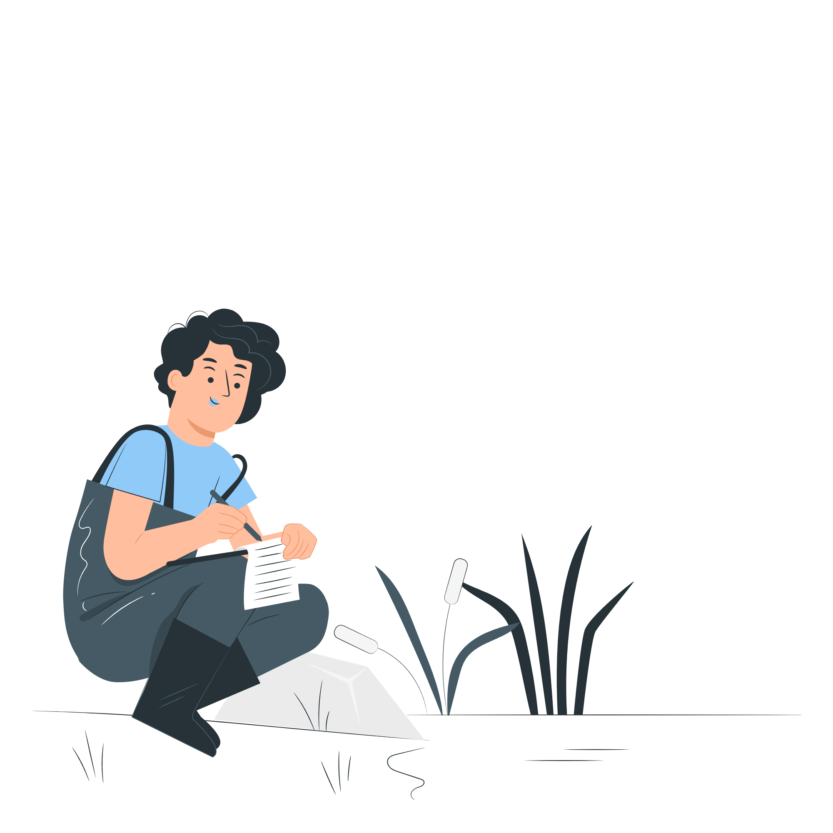
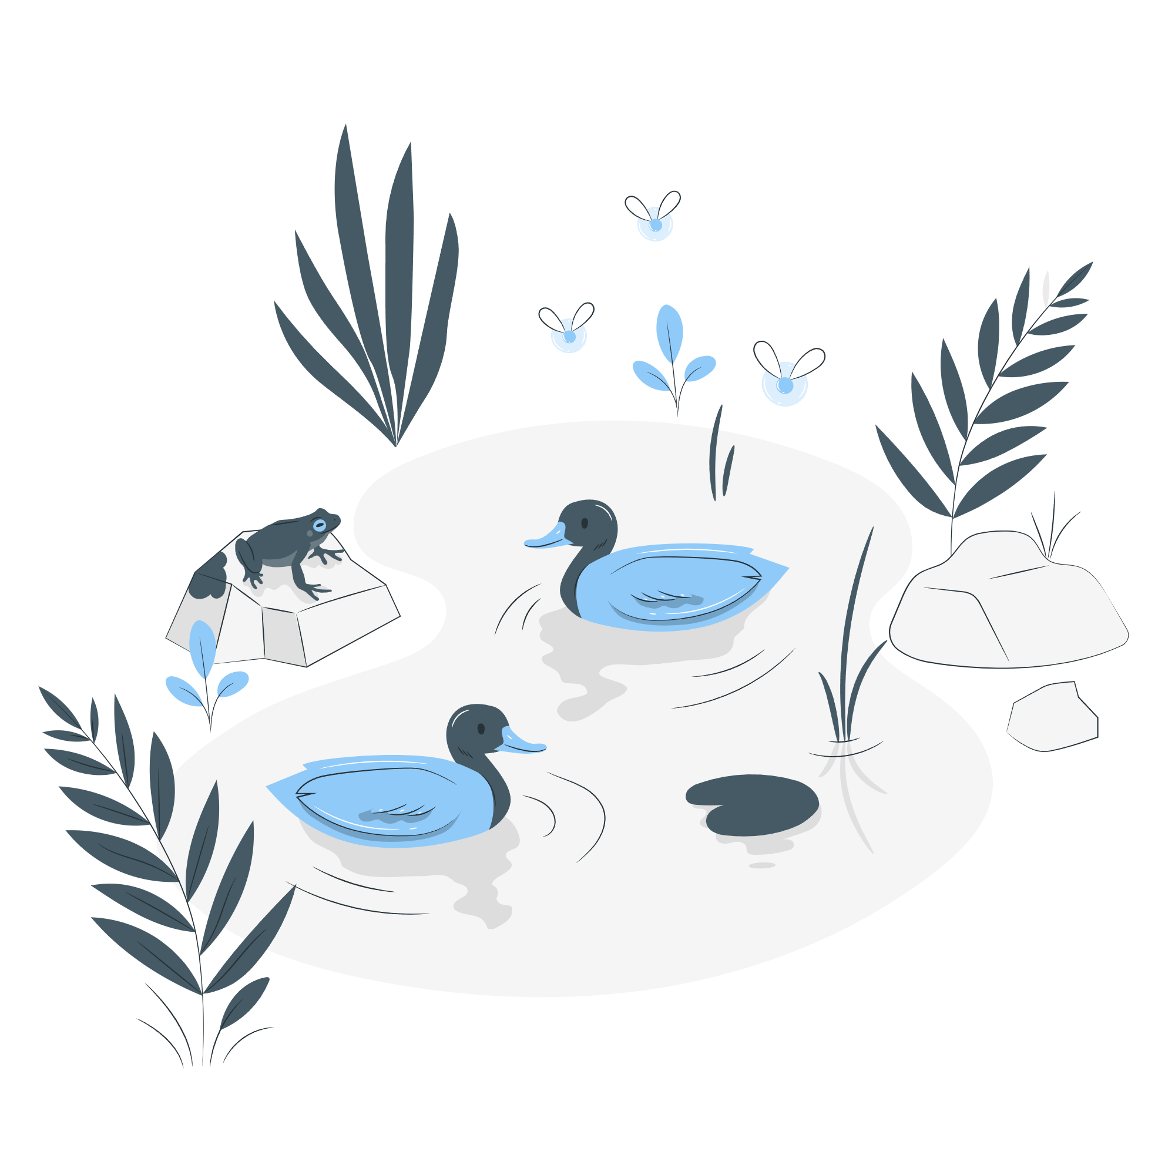
OVERARCHING AND CROSS-CUTTING PILLARS
INTER- AND INTRA-GENERATIONAL JUSTICE
Burden of action not shifted to future generations
Spillover effects not transferred to vulnerable people or Global South
Keep in mind Western overconsumption
MEANINGFUL YOUTH INCLUSION
Opportunities for decision-making engagement.
Right-holders vs. stakeholders.
TRANSFORMATIVE EDUCATION
Open and accessible information
Teachings and practical experiences
Illustrations by Storyset

Slide 8
MORE INFO
Generation Climate Europe https://gceurope.org/
GYBN Europe https://gybnweb.wixsite.com/europe
European Young Rewilders https://youngrewilders.com/
Rewilding Europe https://rewildingeurope.com/
Contact: giulia.testa@rewildingeurope.com

Slide 9
THANK YOU
And have a nice summit!

