Slide 1
CREATING A MOVEMENT
Dam Removal Europe
Pao Fernández Garrido

Slide 2
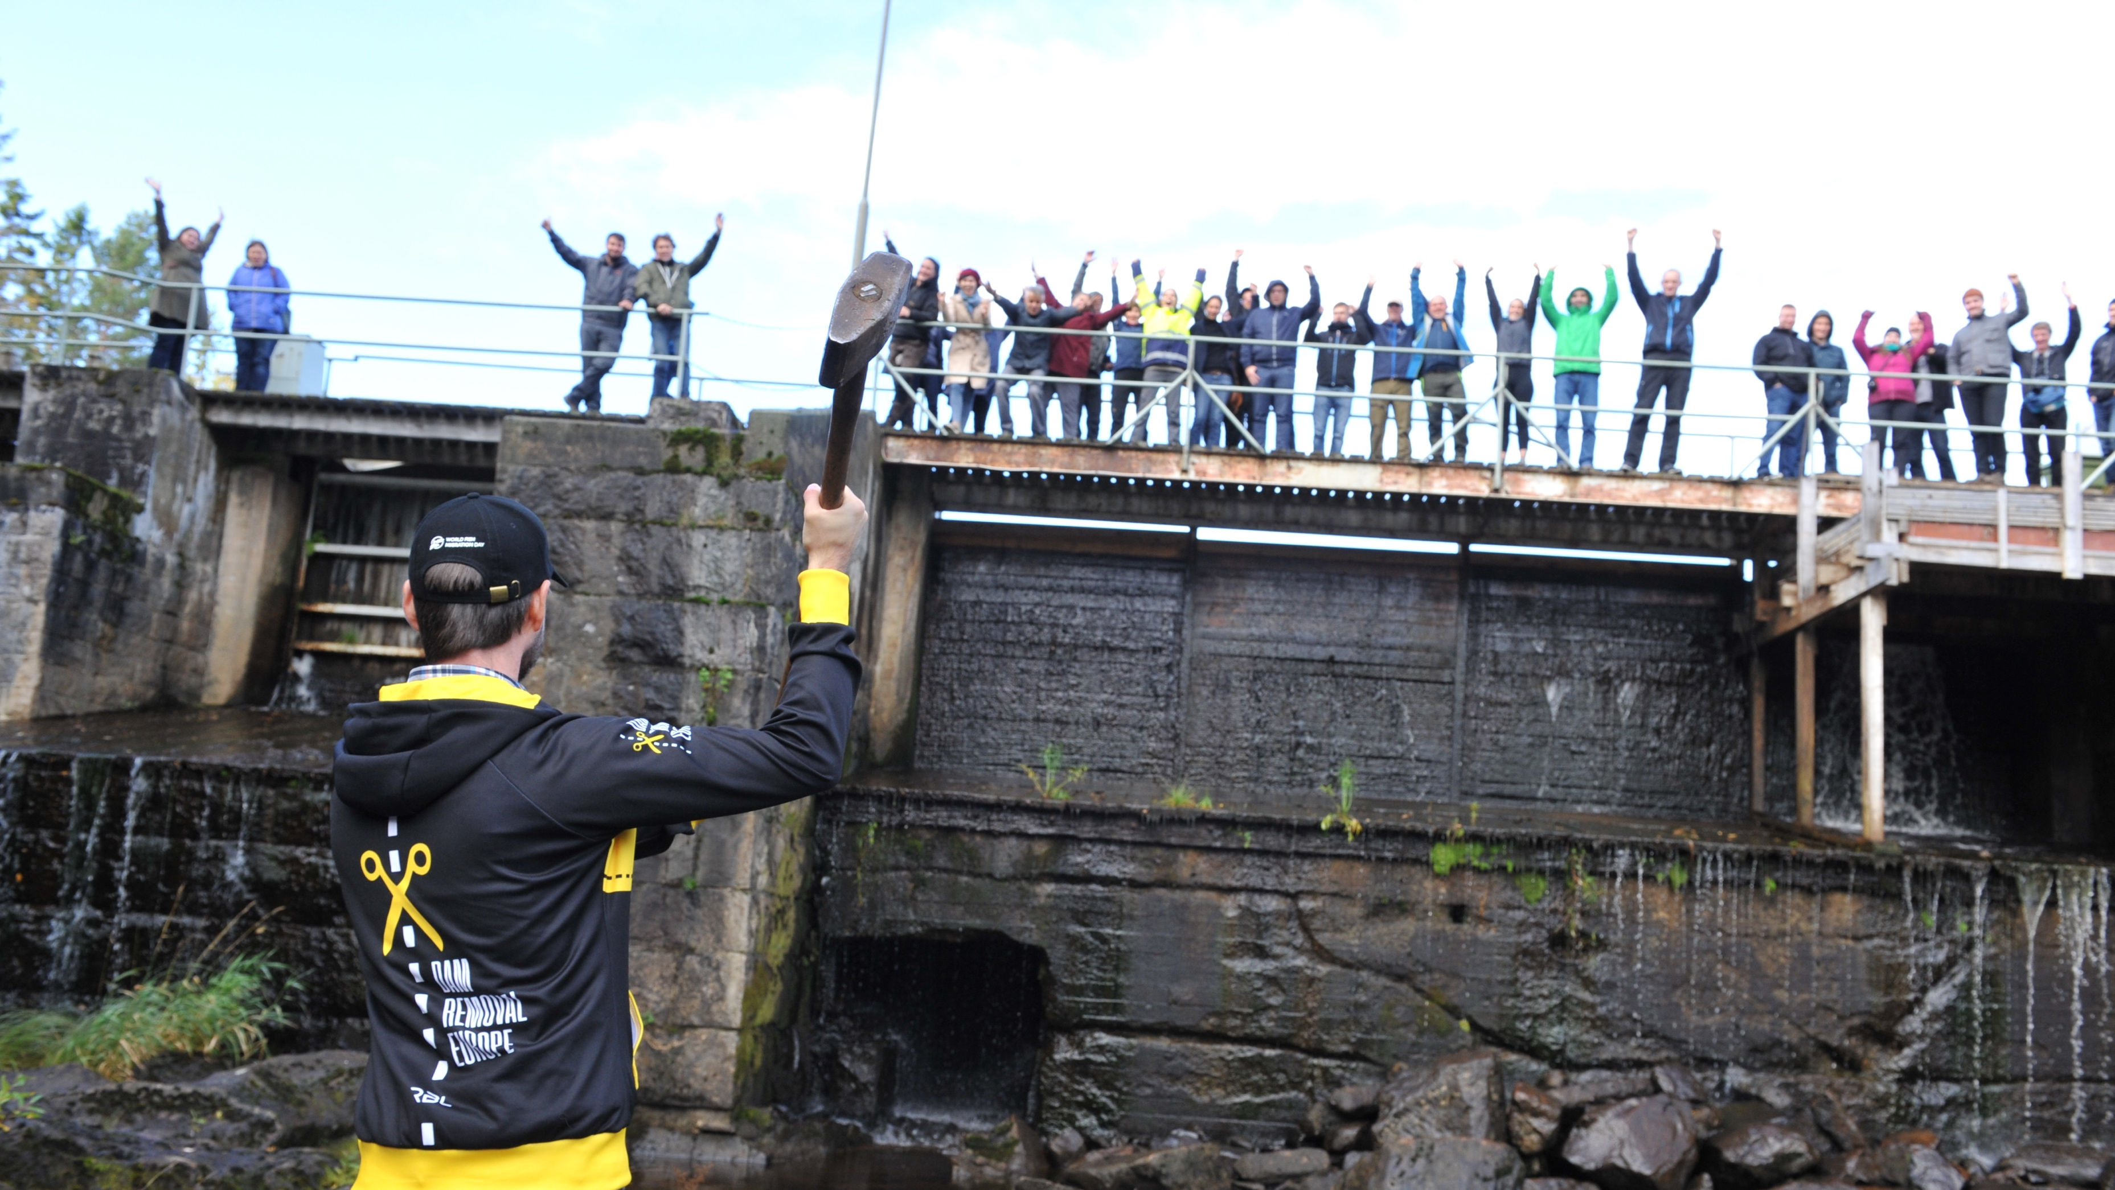
2016
MOVEMENT TO SUPPORT PROFESSIONALS

Slide 4
Economic benefits during and after dam removal works
“Restoration economy”
Restoration projects generate equal to or greater economic benefits than other types of projects such as road and bridge construction”.
Notes:
Massachusetts Division of Ecological Restoration (DER) conducted an analysis in 2011, 2013 and 2015 to estimate the regional economic impacts of spending on restoration projects across the Commonwealth.
The study found that each $1.0 million dollars spent on its restoration projects (including stream barrier removals, as well as salt marsh restoration) supported 10 to 13 jobs and $1.5 to $1.8 million in regional economic output (2009 dollars): contributing to a growing “restoration economy” in Massachusetts.
Restoration projects generate total economic outputs equal to or greater than other types of capital projects such as road and bridge construction and repair, replacement of water infrastructure, etc.

Slide 6
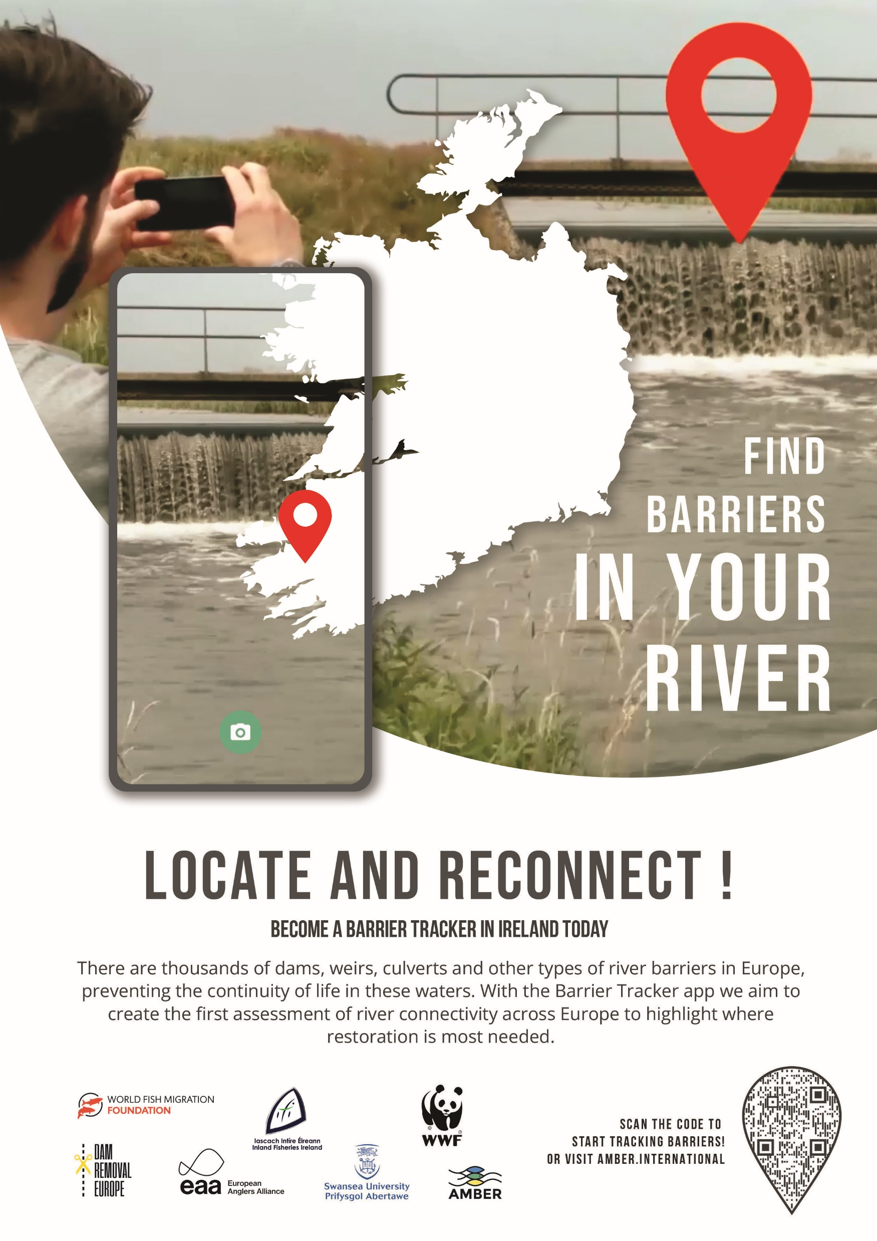
Notes:
Massachusetts Division of Ecological Restoration (DER) conducted an analysis in 2011, 2013 and 2015 to estimate the regional economic impacts of spending on restoration projects across the Commonwealth.
The study found that each $1.0 million dollars spent on its restoration projects (including stream barrier removals, as well as salt marsh restoration) supported 10 to 13 jobs and $1.5 to $1.8 million in regional economic output (2009 dollars): contributing to a growing “restoration economy” in Massachusetts.
Restoration projects generate total economic outputs equal to or greater than other types of capital projects such as road and bridge construction and repair, replacement of water infrastructure, etc.

Slide 7
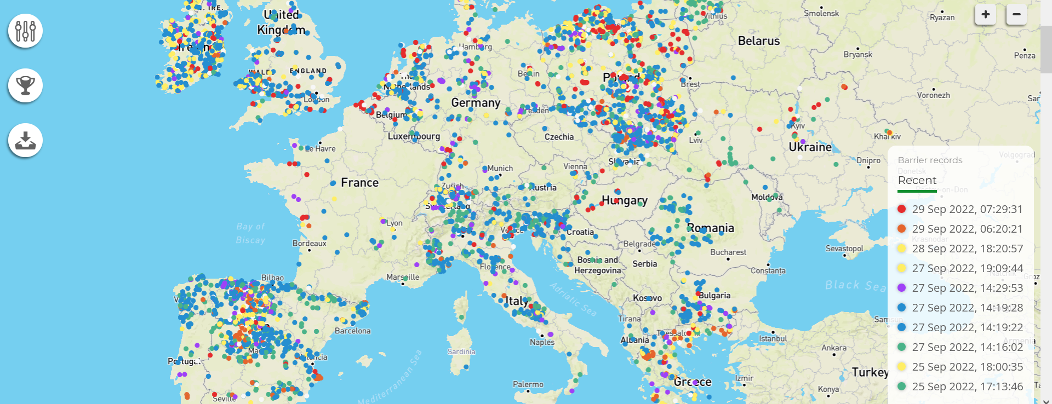
Notes:
Massachusetts Division of Ecological Restoration (DER) conducted an analysis in 2011, 2013 and 2015 to estimate the regional economic impacts of spending on restoration projects across the Commonwealth.
The study found that each $1.0 million dollars spent on its restoration projects (including stream barrier removals, as well as salt marsh restoration) supported 10 to 13 jobs and $1.5 to $1.8 million in regional economic output (2009 dollars): contributing to a growing “restoration economy” in Massachusetts.
Restoration projects generate total economic outputs equal to or greater than other types of capital projects such as road and bridge construction and repair, replacement of water infrastructure, etc.

Slide 8
LITUANIA

Slide 9
SPAIN

Slide 10
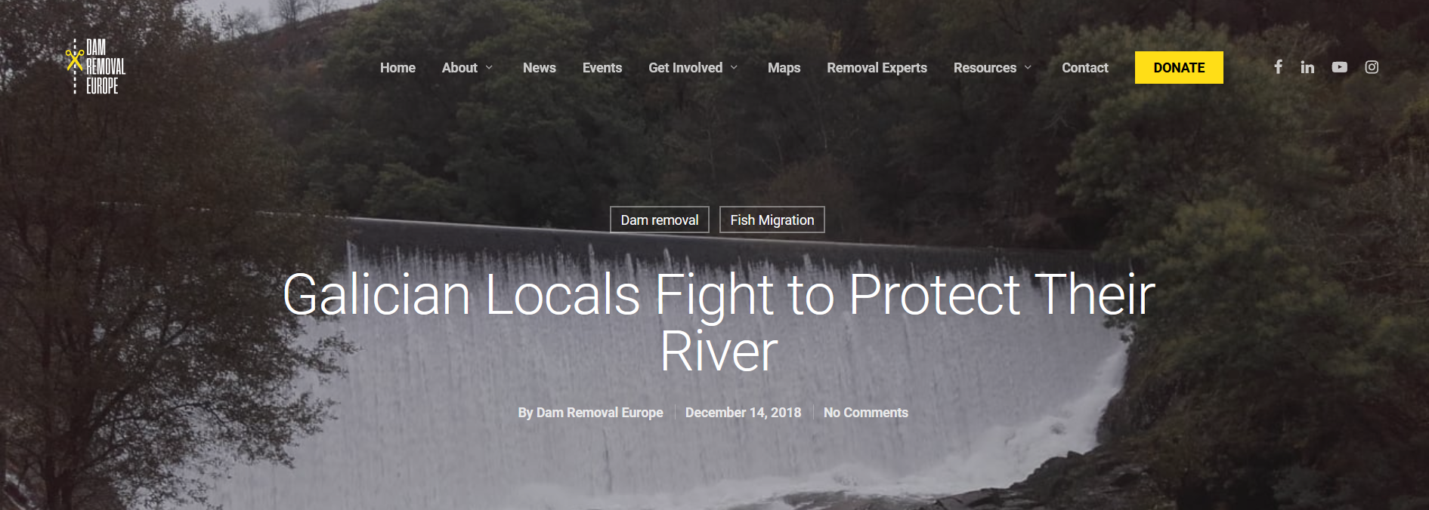
SPAIN
DRE newsletter

Slide 11
UKRAINE

Slide 12
€42,5 M to remove small barriers
https://openrivers.eu/

Slide 13
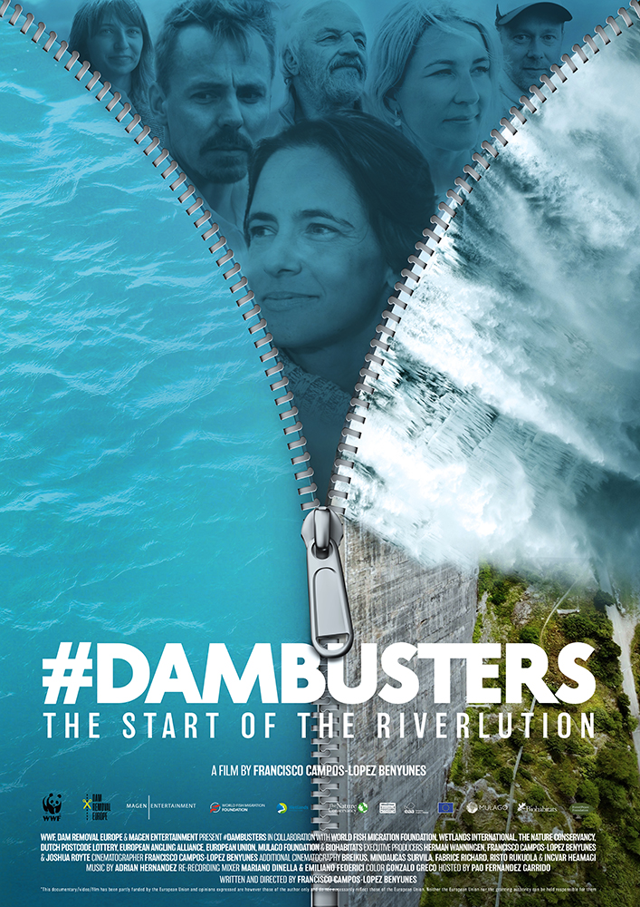
https://www.dambusters.net/

Slide 14
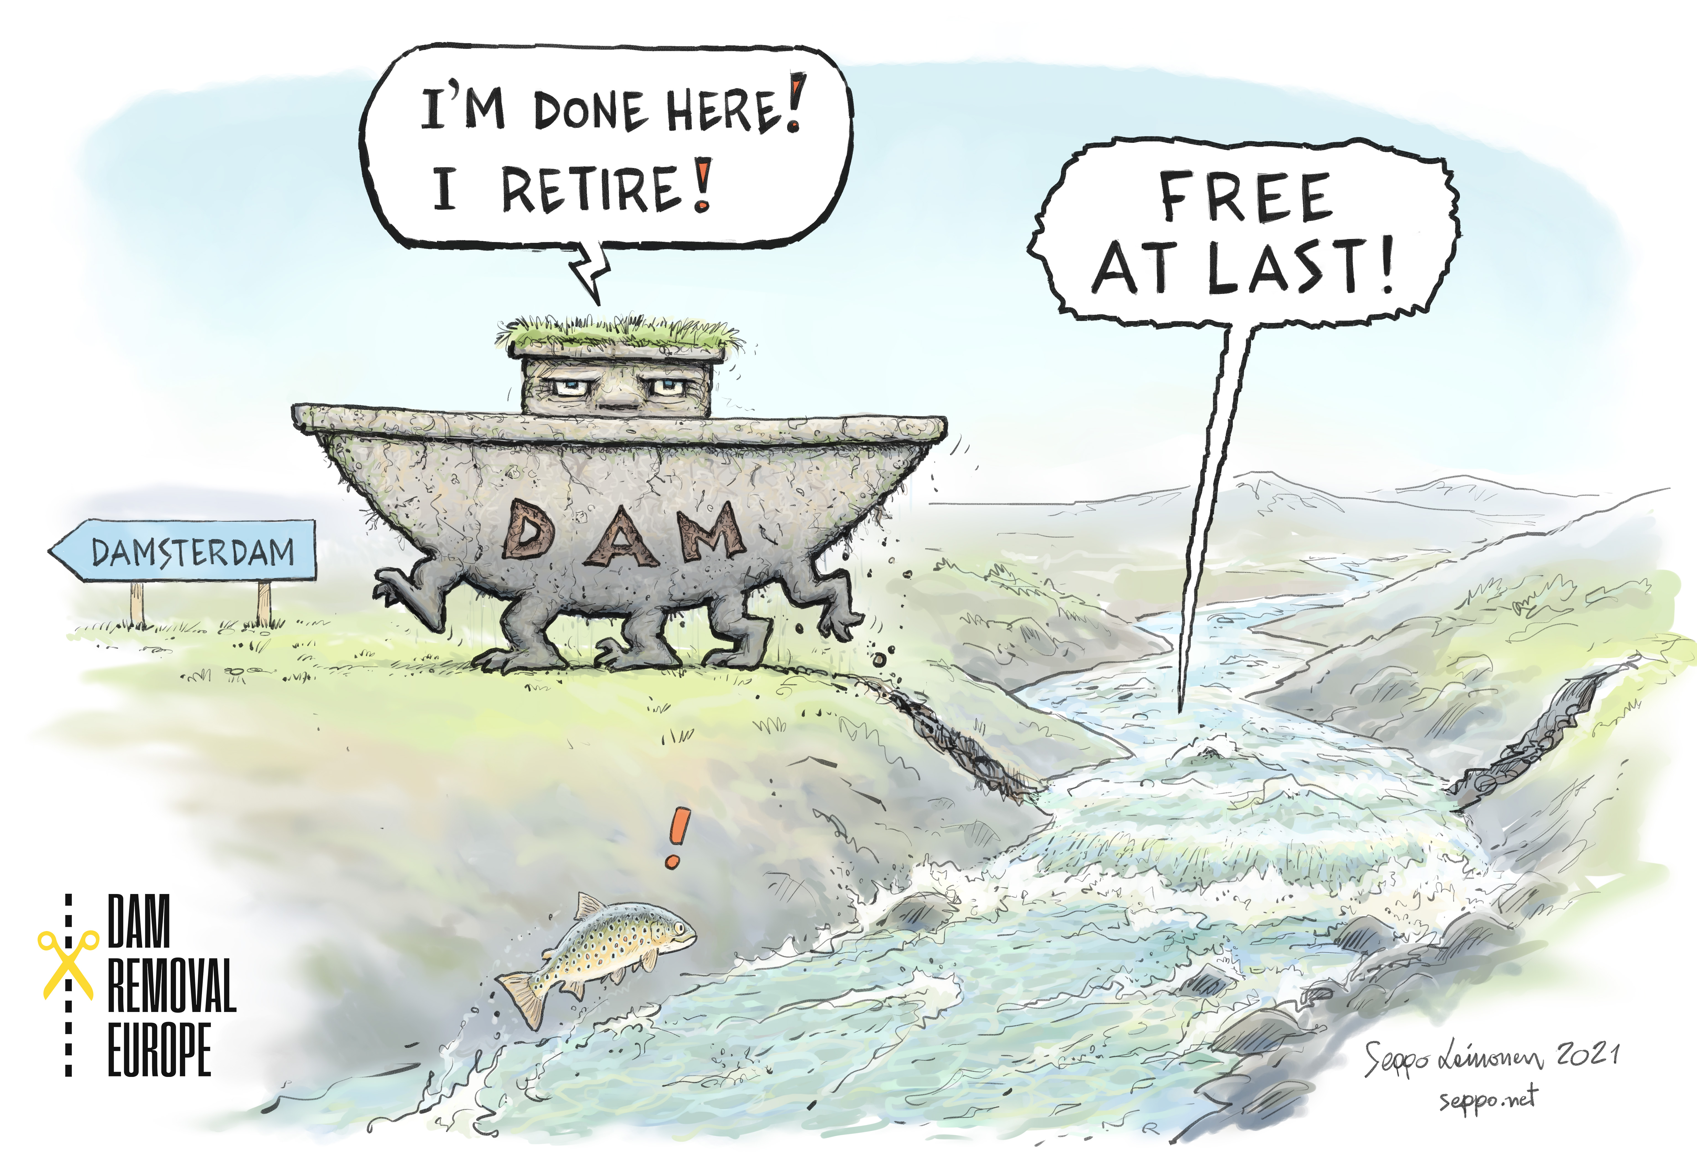
Pao Fernández Garrido
pao@fishmigration.org
Thank you so much!

