Slide 1
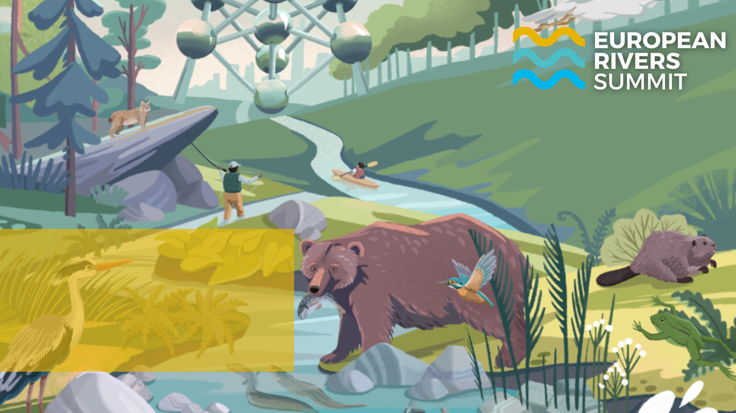
Lawyers for Rivers
Maja Pravuljac, ClientEarth

Slide 2
What is Lawyers for Rivers?
Initiative to connect national and international legal experts in optimising legal compliance of hydropower projects with environmental laws and ensuring protection of rivers, species and habitats;
Sharing legal expertise between the legal experts and NGOs, activists and local community.

Slide 3
How does it work in practice?
Regular meetings between national and international legal experts and NGOs;
Discussing legal interventions and exchanging legal expertise;
Launching cases before national authorities and courts, and international bodies in case of identified noncompliance with national and international laws.

Slide 4
Which international legal tools do we use?
Complaints to the:
Energy Community Secretariat;
Aarhus Convention Compliance Committee;
Espoo Convention Implementation Committee;
Bern Convention Secretariat;
European Commission.

Slide 5
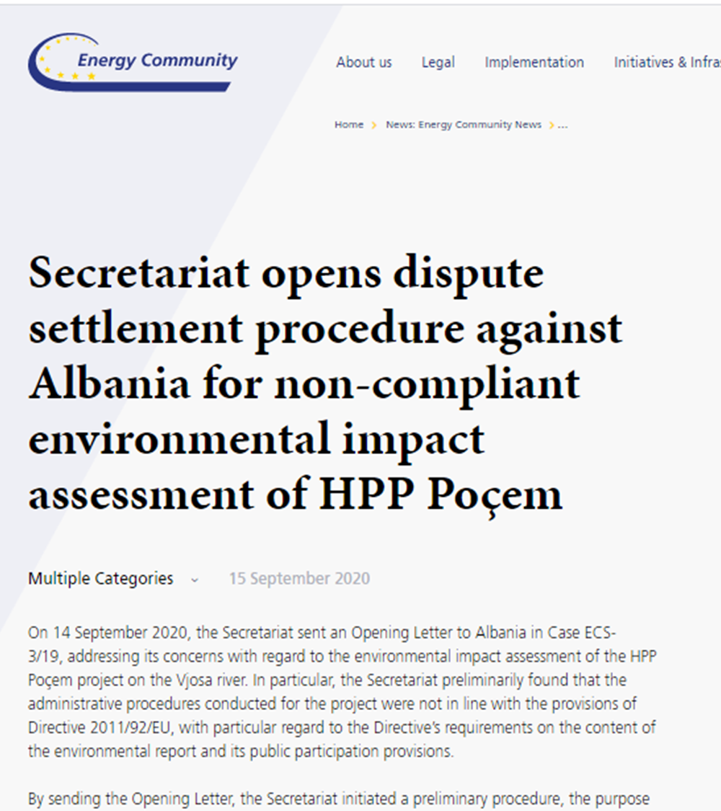
Examples of interventions – Energy Community
4 complaints submitted to the Secretariat for protection of rivers in Albania, Bosnia and Herzegovina and Serbia.
Possible outcome:
formal infringement procedure

Slide 6
Examples of interventions – Energy Community
Possible outcome:
Implementation reports commenting on non-compliance
Serbia failed to transpose Directive 2014/52/EU. Future amendments should also address the failure to issue construction permits (development consent) only after EIA consent (or an EIA decision) is granted, as well as the lack of EIA screening of HPP projects with less than 2 MW of installed capacity located outside protected areas.

Slide 7
Examples of interventions – Bern Convention
Impact on wild flora and fauna species and their habitats
Complaints submitted:
Upper Neretva candidate Emerald site in Bosnia and Herzegovina
Vjosa river in Albania
Possible outcome: on-spot appraisal, the Standing Committee Recommendations

Slide 8
Espoo Convention and the Kyiv (SEA) Protocol
Transboundary environmental impact
information submitted – likely transboundary impact on the UNESCO protected Tara national park in Montenegro.
Possible outcome: the report and the recommendations of the Committee.
River Tara ©Riverwatch

Slide 9
THANK YOU
And have a nice summit!

