Slide 1
Pisão Dam – a Tale of Significant Harm
Ana Catarina Miranda

Slide 2
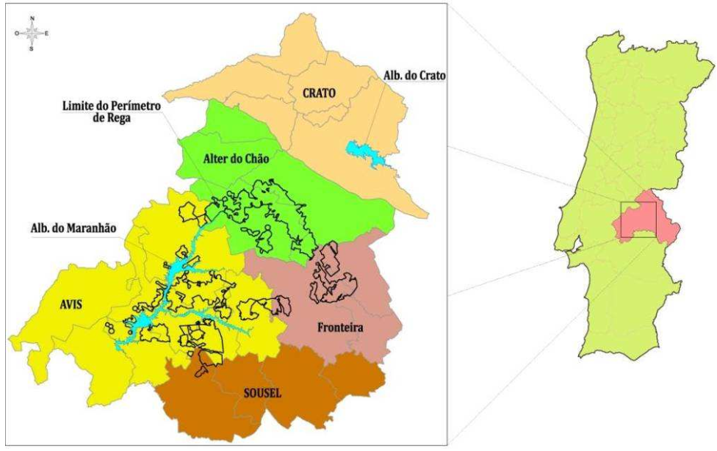
PISÃO DAM - LOCATION
Notes:
Municipalities affected by the Dam
Dams in Blue
Irrigation blocks fed by the dam in black

Slide 3
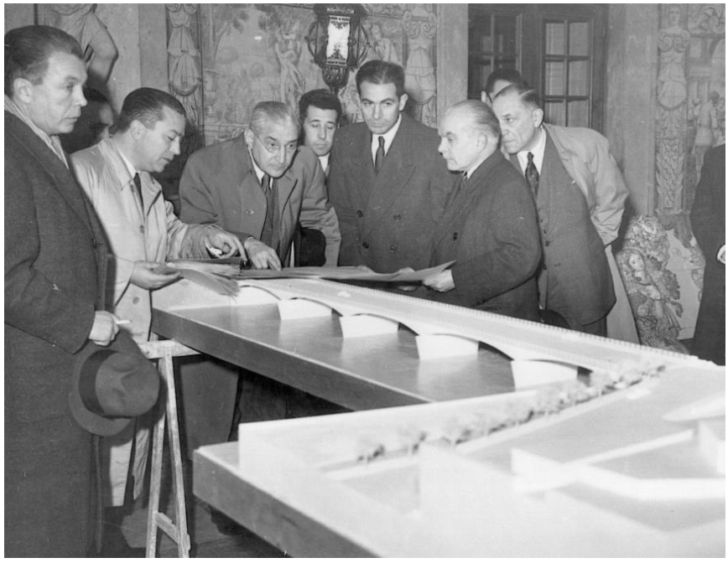
A TALE OF 8 DECADES
Notes:
1940’s
120 million euros from resilience funds

Slide 4
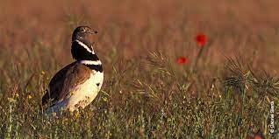
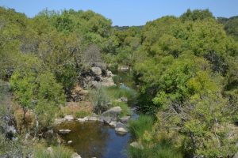
PISÃO DAM – NATURAL VALUES OF AFECTED AREA

Slide 5
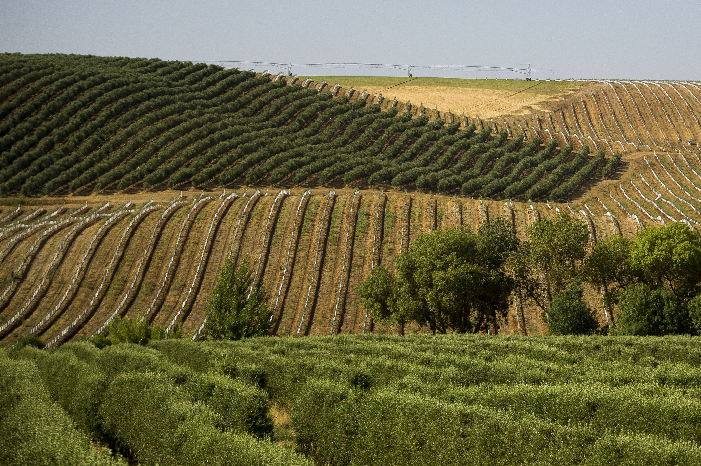
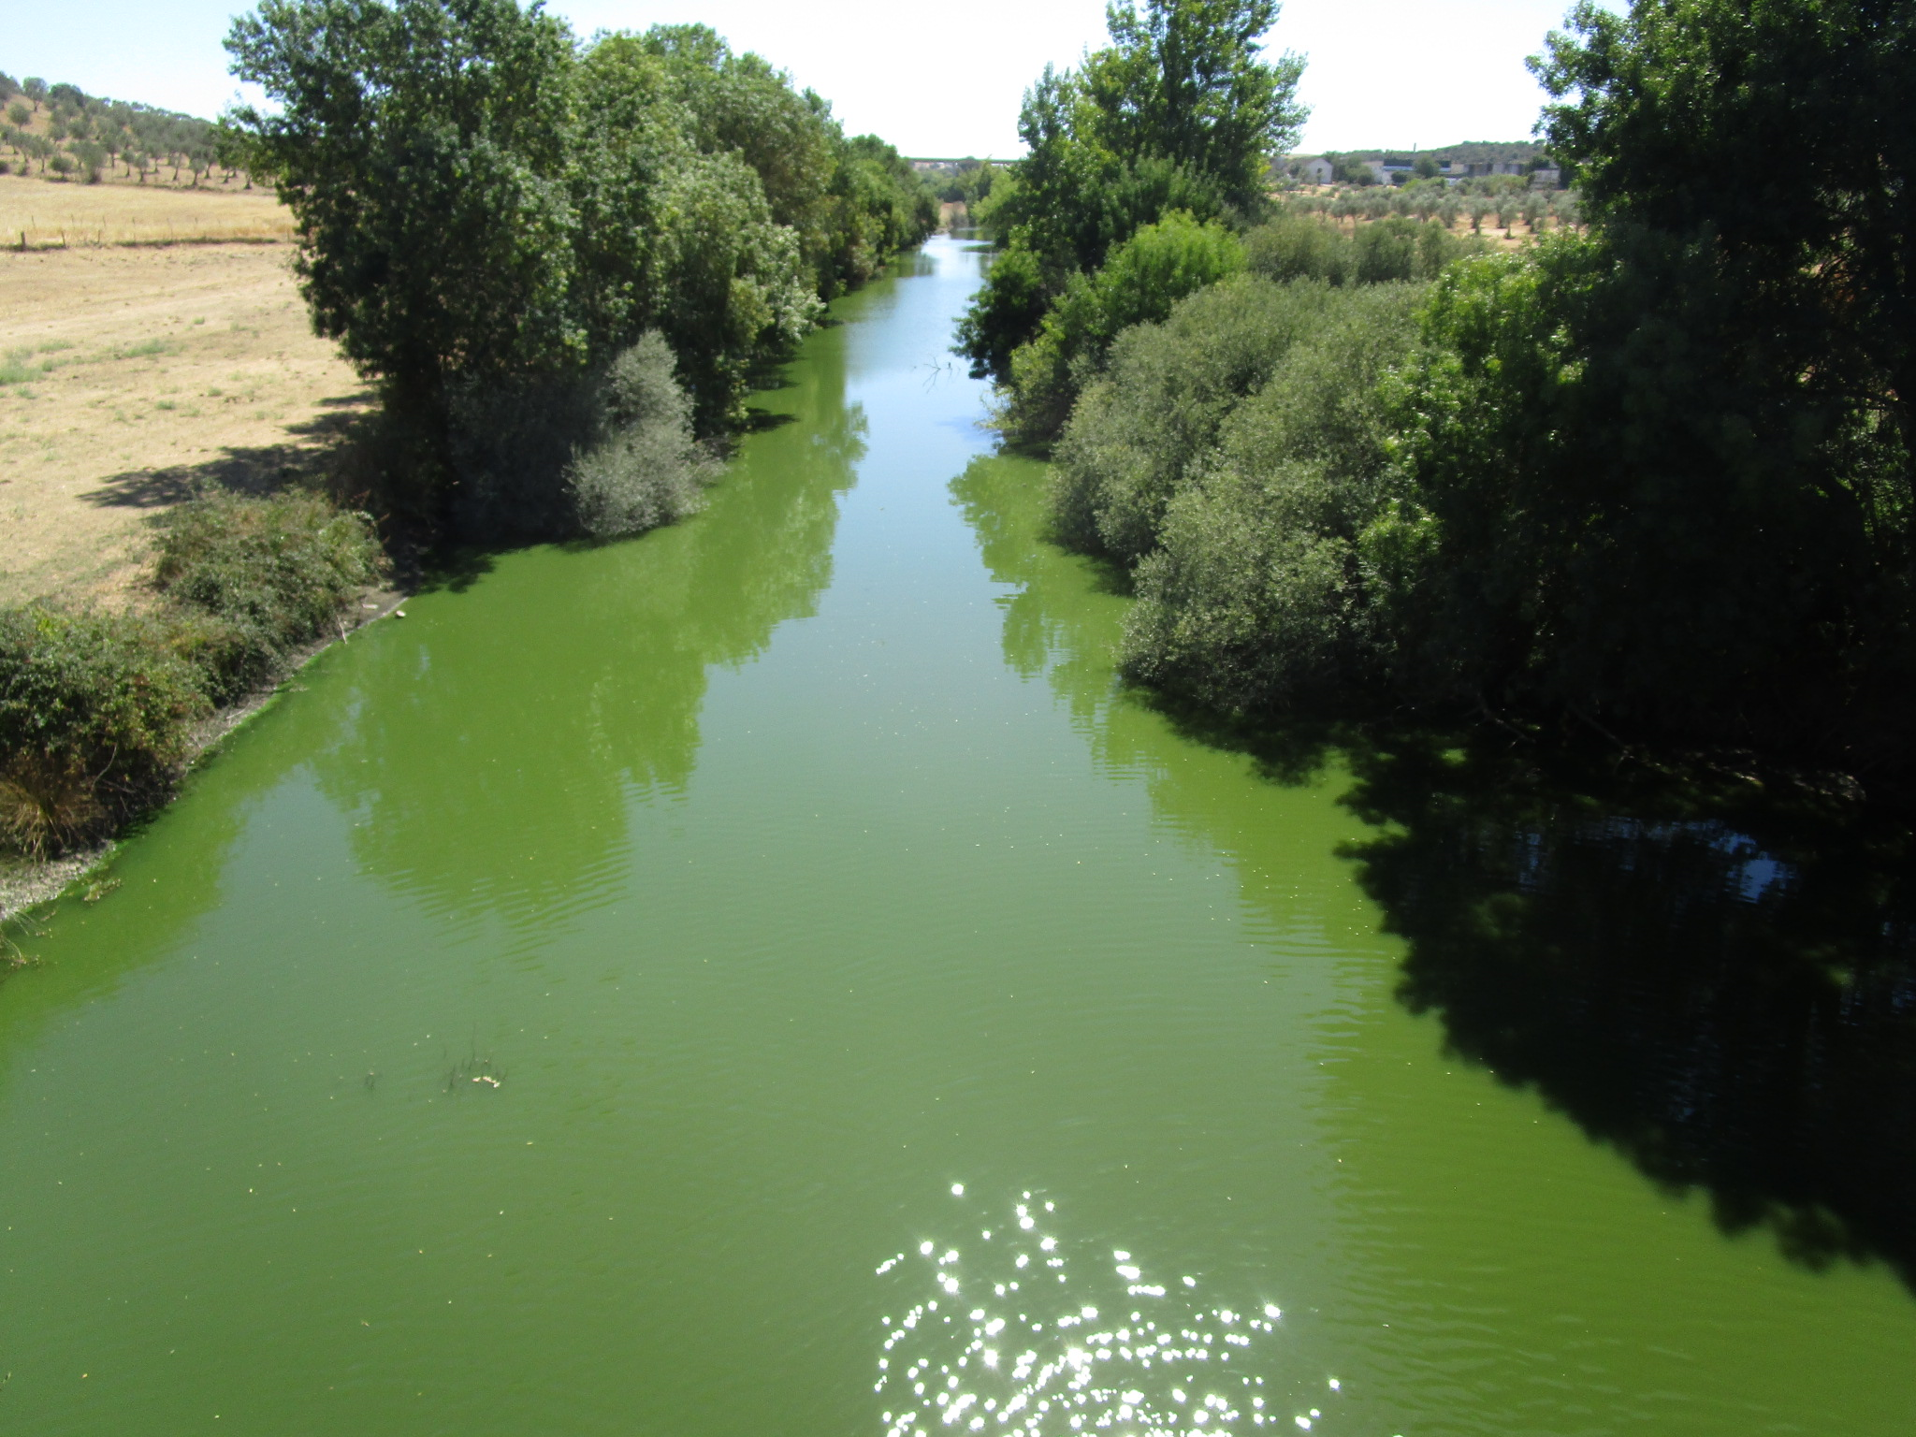
PISÃO DAM – EXPECTATIONS

Slide 6
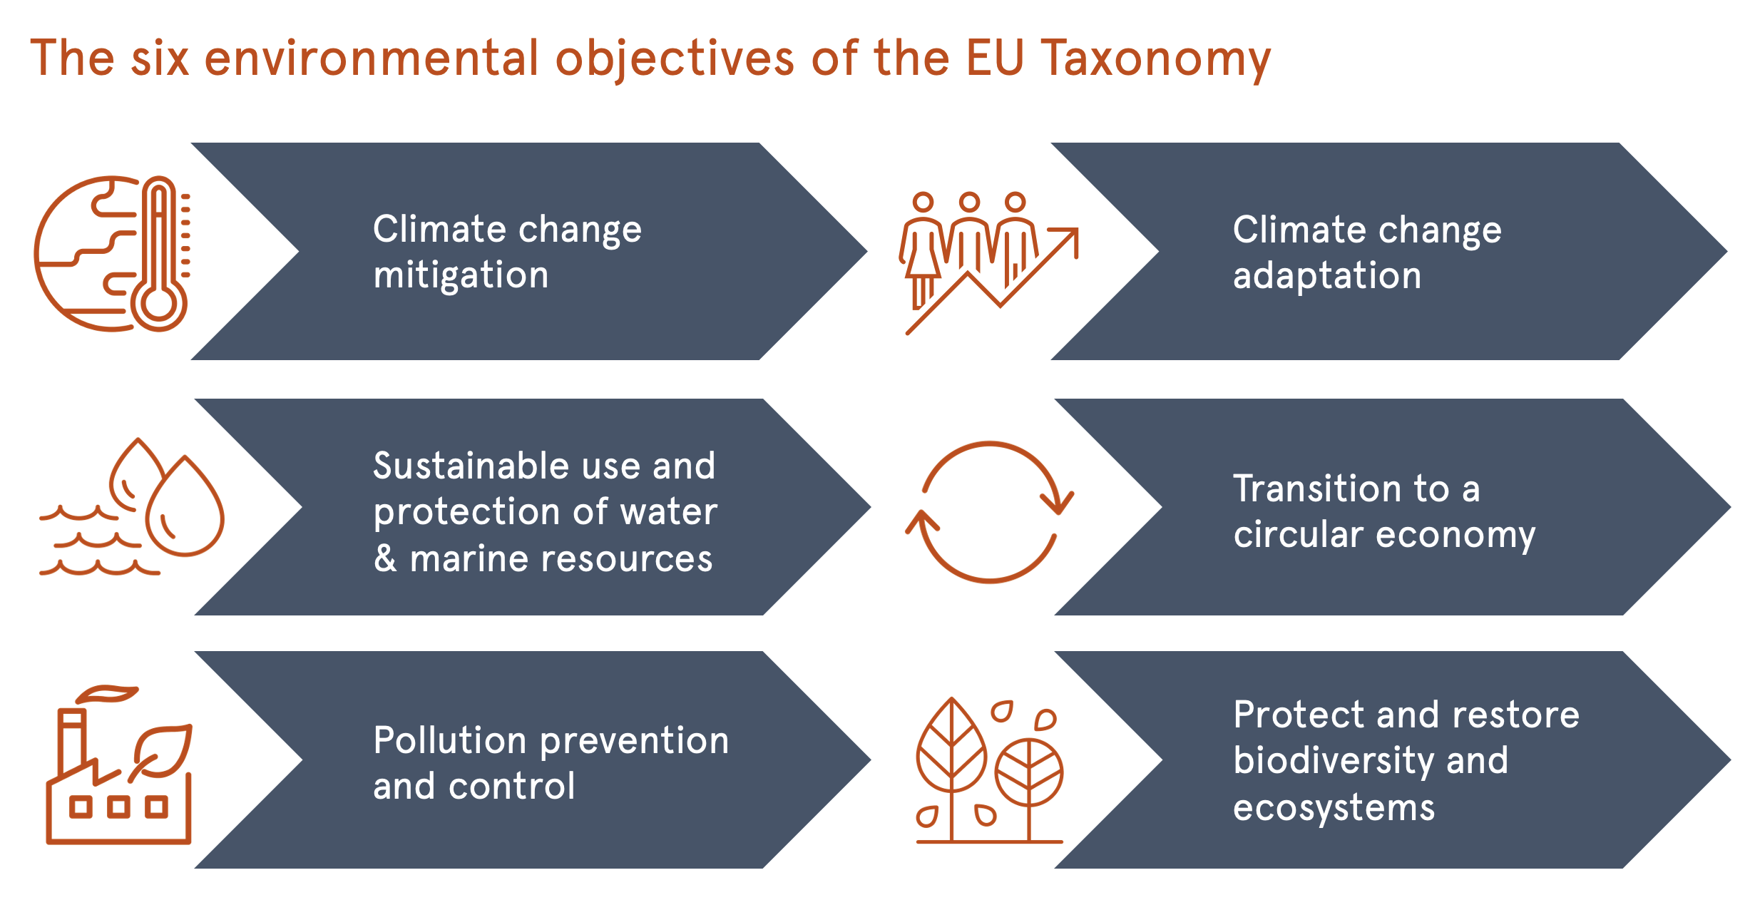
PISÃO DAM & THE DO NO SIGNIFICANT HARM PRINCIPLE

Slide 7
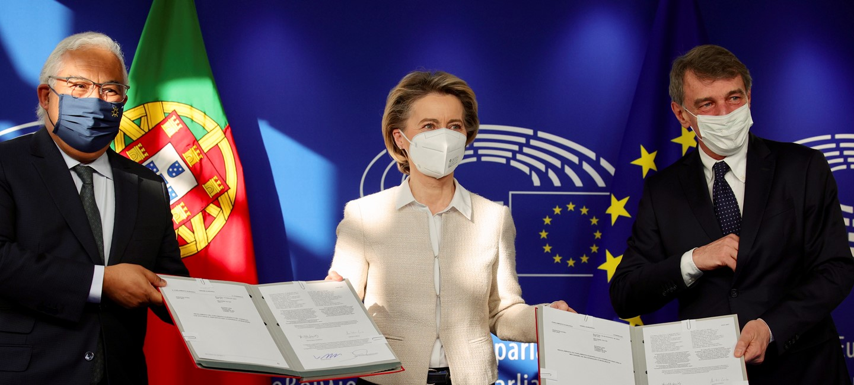
PISÃO DAM & THE DO NO SIGNIFICANT HARM PRINCIPLE

Slide 8
THANK YOU
And have a nice summit!
cmiranda@geota.org

