Slide 1
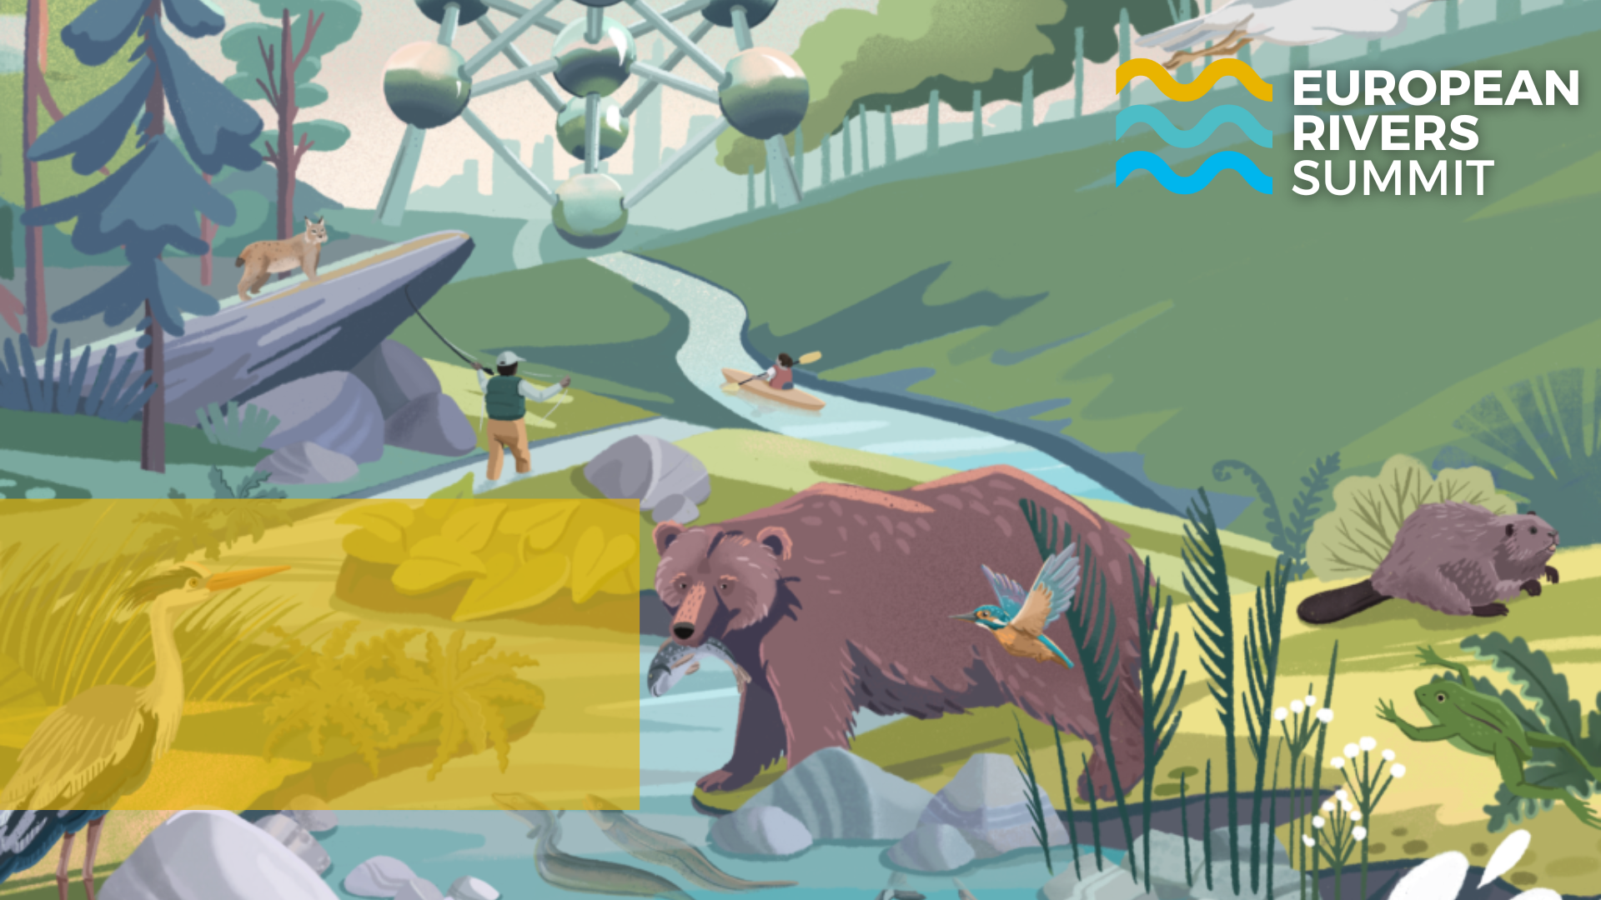
The fight against hydropower in the context of the revision of the renewable energy directive
Marilena D’auria
EuroNatur – Policy Team

Slide 2
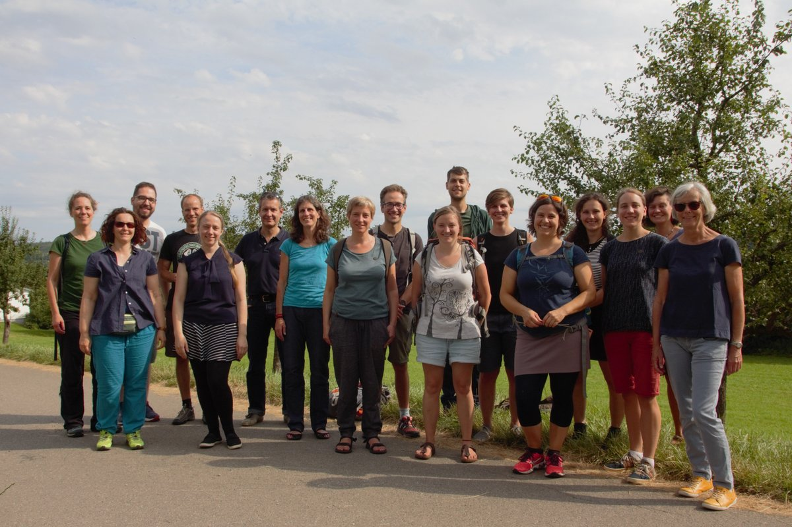
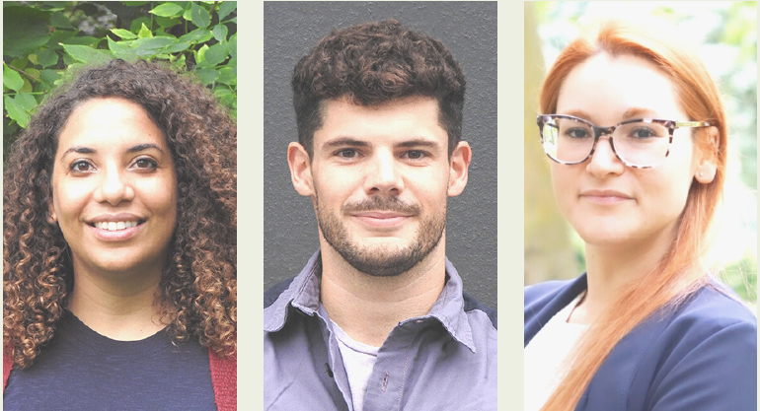
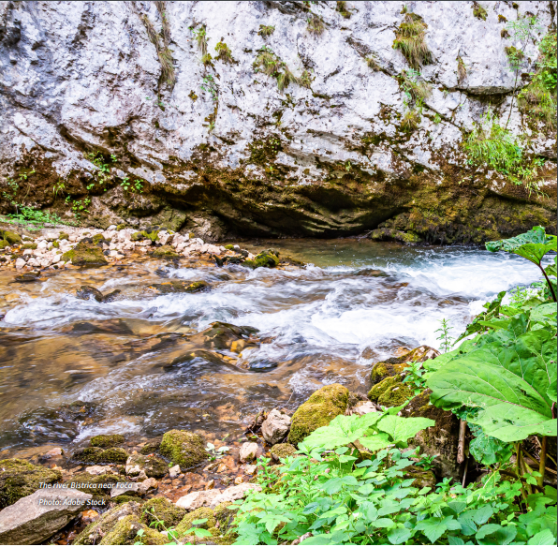
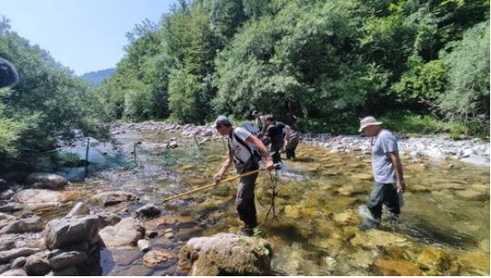
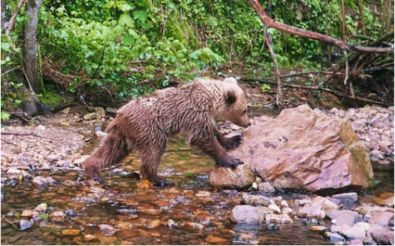
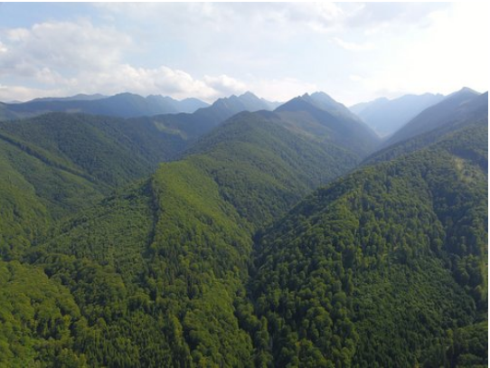
European NGO based in Radolfzell and in Brussels
Focus on nature conservation in Central and Eastern Europe
Connecting nature and people via a well-established network of partner organisations, scientists and conservation practitioners
Thematic areas: freshwater ecosystems, forests, migratory birds and large carnivores, cultural landscapes.
EuroNatur: Who are we?

Slide 3
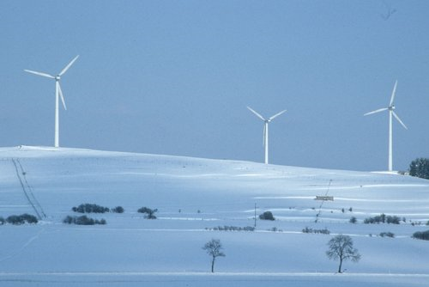
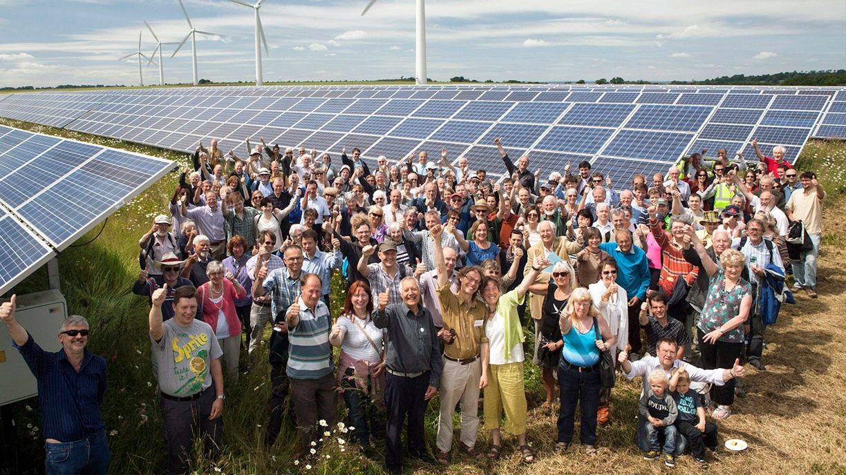
Energy solutions that can tackle the ecological and climate crises jointly.
Renewable Energy Directive (RED): an opportunity to align priorities
No more energy production from environmentally unsustainable forms of energy such as forest biomass and hydropower
Prioritise solar, wind and geothermal energy sources.
Planning with low impact on nature
EuroNatur VISION
@Dietmar Nill
@Community Power Agency

Slide 4
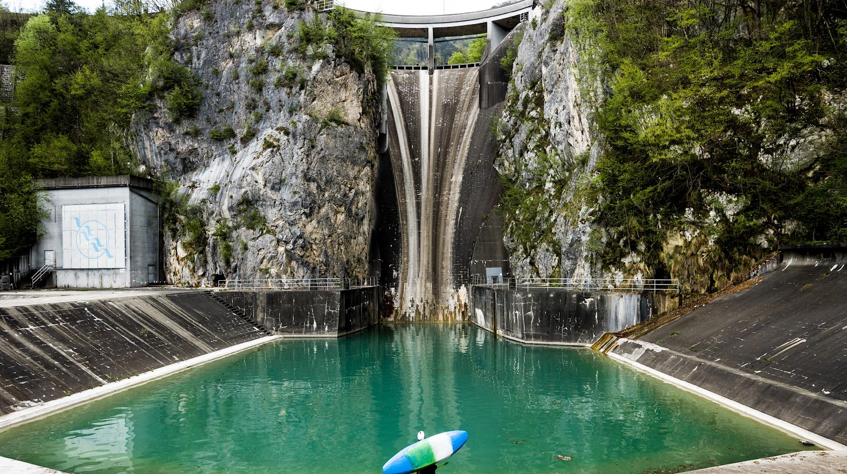
Hydropower plants disrupt the ecologically critical connectivity of a river by chopping it into pieces and diverting its flow through pipes and tunnels
HPP Moste, Sava Dolinka River, Slovenia
@Jan Pirnat

Slide 5
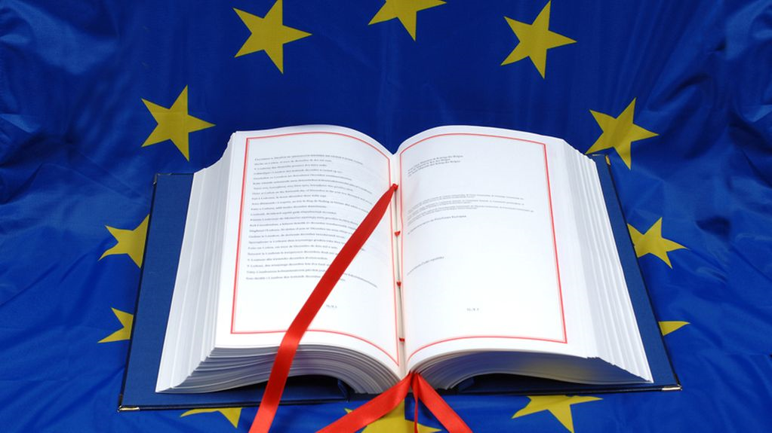
Treaty on the Functioning of the EU (TFEU):
The EU can adopt measures and legal acts on energy
BUT Member States decide the conditions e.g. which energy sources and the structure of their energy mix
EU Energy policy: general principles
@Council of the EU

Slide 6
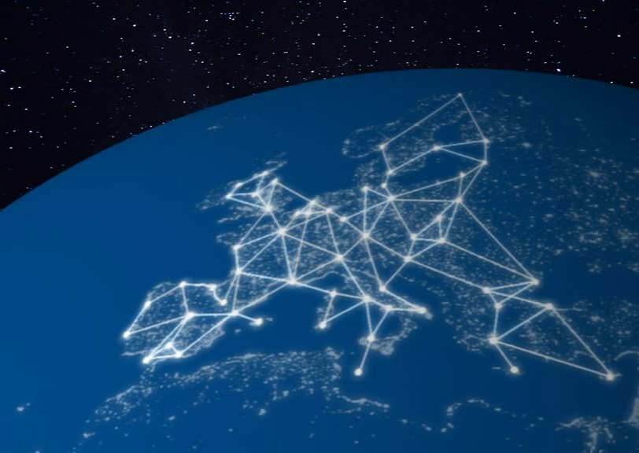
According to the Energy Union, the five main aims of the EU energy policy are to:
Diversify Europe’s sources of energy in order to ensure energy security
Ensure the functioning of a fully integrated internal energy market
Improve energy efficiency and reduce dependence on energy imports, cut emissions, and drive jobs and growth
Decarbonise the economy in line with the Paris Agreement
Promote R&I in clean energy technologies

Slide 7
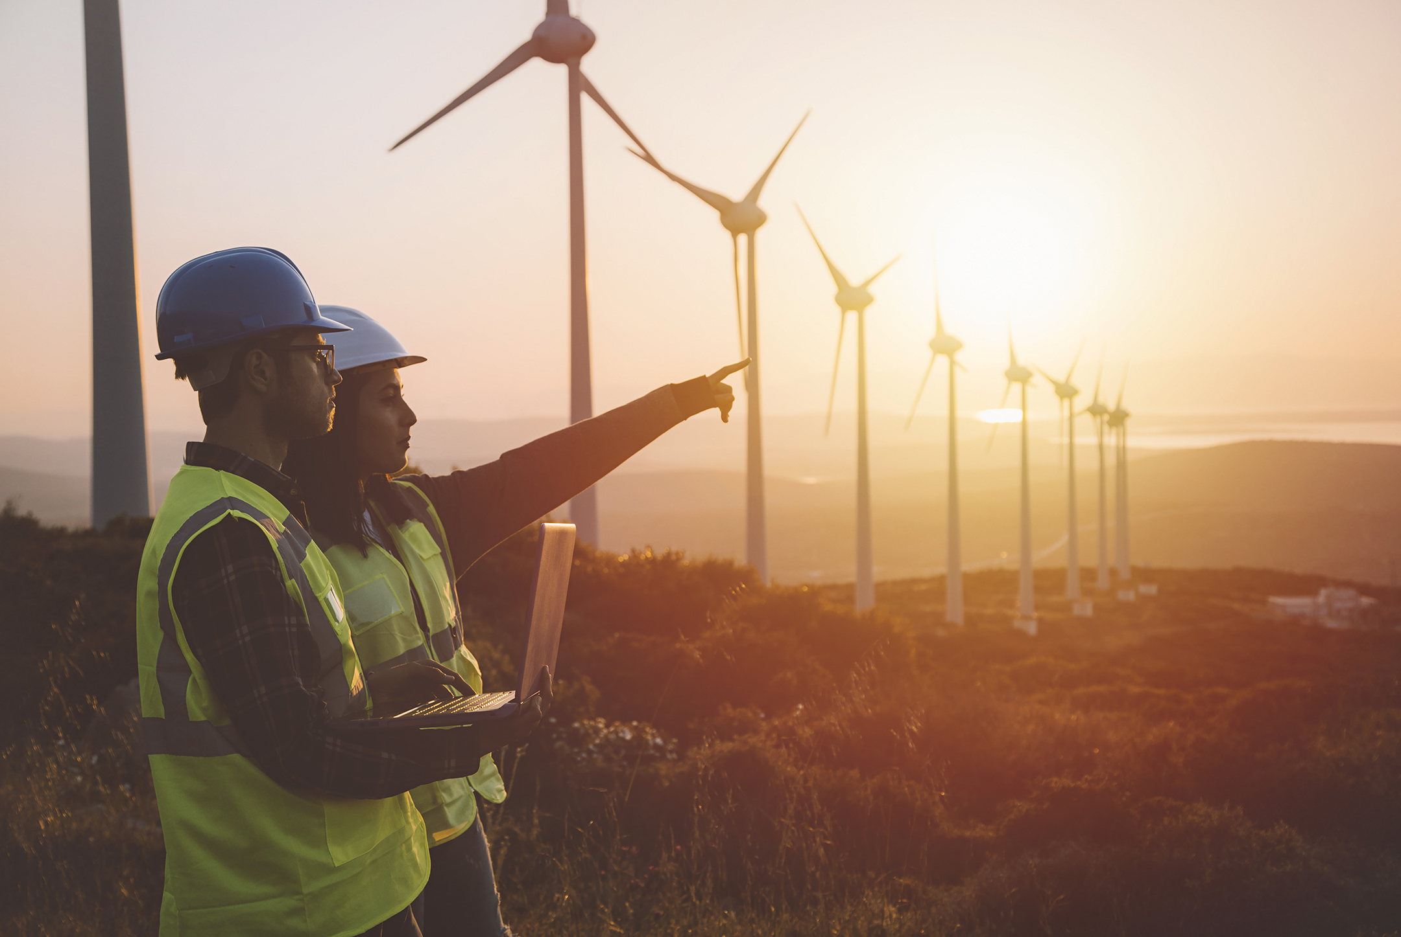
The EU promotes renewable energy in order to:
Reduce GHG emissions
Improve competition and reduce dependency on imported energy
Create new jobs
Renewable energy in the EU
@Getty images

Slide 8
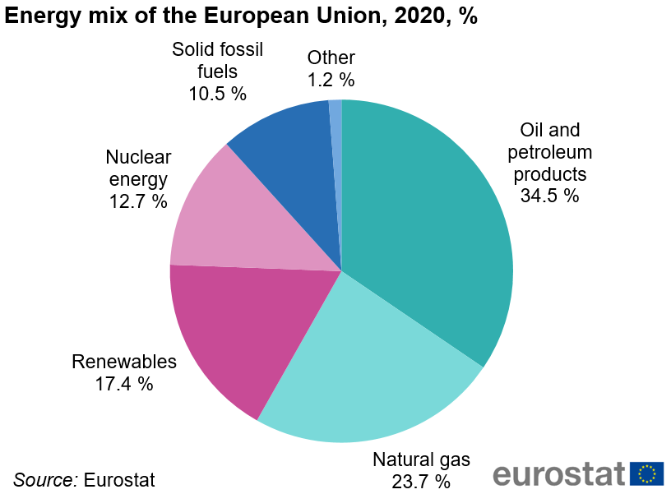
Renewable energy in figures

Slide 9
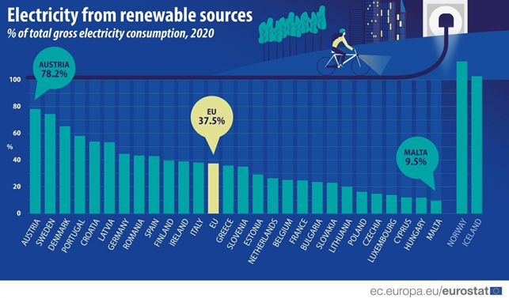
Renewable energy in figures

Slide 10
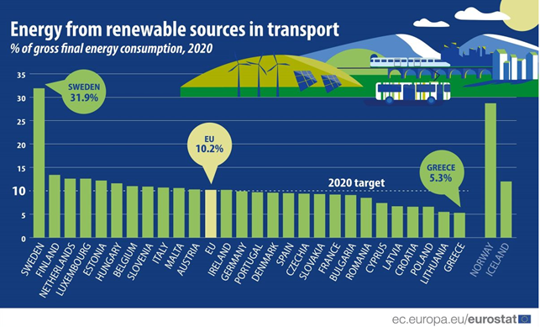
Renewable energy in figures

Slide 11
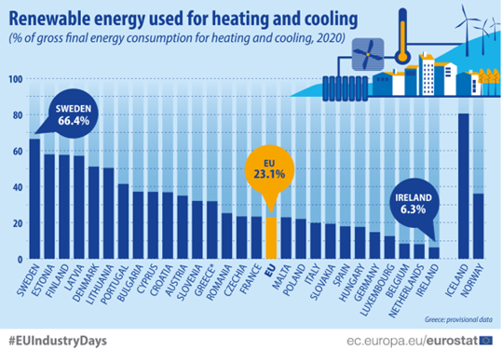
Renewable energy in figures

Slide 12
Renewable energy targets – a timeline
Over time, the EU has adopted a series of specific measures and targets for to increase RES in the energy mix:
2010
Directive 2001/77/EC
12% of gross domestic energy consumption
Indicative & non-binding targets for MS
2020
Renewable Energy Directive 2009/28/EC (REDI)
20% of gross final energy consumption
Binding and differentiated national targets
2030
Renewable Energy Directive (EU) 2018/2001 (REDII)
32% of the share of renewable energies in energy consumption
No national binding targets but National Energy and Climate Plans (NECPs)

Slide 13
Setting the path towards climate neutrality
December 2019
European Green Deal: European Commission‘s plan to reach climate neutrality by 2050, deliver the commitments under the international Paris Agreement and international Biodiversity commitments
June 2021
European Climate law: legal obligation for the EU to cut net greenhouse gas emissions by at least 55% by 2030 and reach climate neutrality by 2050
July 2021
Fit for 55 package: revision of climate-, energy- and transport-related legislation to align EU laws with the European Green Deal ambitions - including the Renewable Energy Directive.

Slide 14
Two legislative proposals by the European Commission are currently revising the renewable energy directive (RED II):
RED III -
Fit for 55 Package
It sets a new EU target of a minimum 40% share of renewables in final energy consumption by 2030 and new sectoral targets & criteria
The revision of the Renewable Energy Directive
RED IV -
REPowerEU Plan
It raises the renewable energy target to a 45% share by 2030 to accelerate the phase-out of the EU‘s dependence on Russian energy imports and the transition to climate neutrality

Slide 15
The current renewable energy directive (RED II) adopted in 2018 defines hydropower as a renewable energy source.
It doesn’t recognise the negative impact of hydropower on nature and therefore doesn’t include any sustainability criteria for hydropower
BUT the Taxonomy Regulation’s Delegated Acts adopted in 2021 did!

Slide 16
RED III – Fit for 55 Package
29 June 2022 - Council position: no safeguards for hydropower against its impact on nature
14 September 2022 - European Parliament (EP): Hydropower is a renewable source of energy and with a weak safeguards
The revision of the Renewable Energy Directive: a focus on hydropower

Slide 17
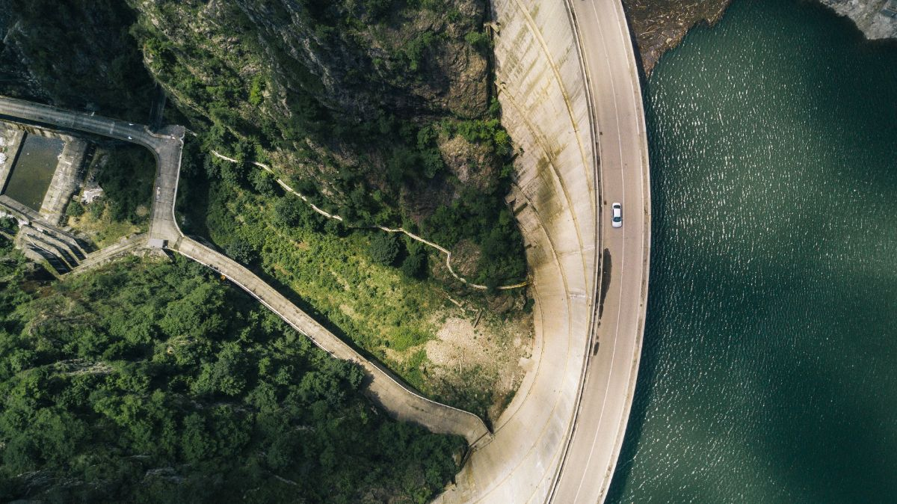
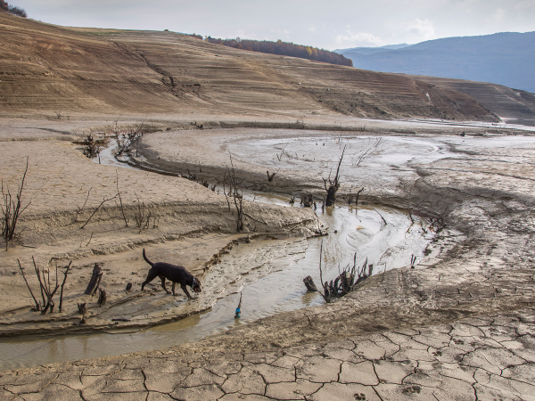
EuroNatur’s view
Hydropower is not green and it doesn‘t contribute to climate change mitigation and adaptation
Exclude new Hydropower from RED targets
Ambitious sustainability criteria for existing and new hydropower plants
Vidrau HPP, Argeș River, Romania
© Jaromír Irkavan
Rama HPP, Rama River, Bosnia & Herzegovina
© Mirsad Mujanovic

Slide 18
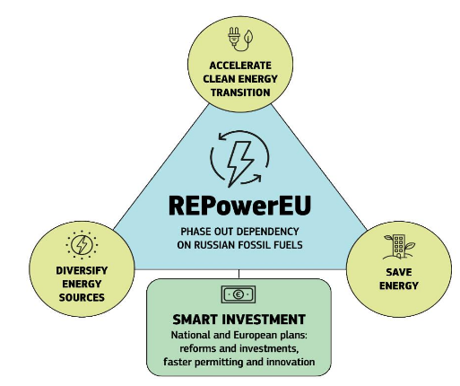
Why a REPowerEU Revision?
Break away from Russian fossil fuels
Accelerate the deployment of renewables

Slide 19
RED IV – REPowerEU Revision
The European Commission’s targeted amendments to RED concern:
Mapping of areas for RES deployment
The designation of “renewables go-to areas”
The acceleration of the permit-granting process
The definition of renewable energy as an overriding public interest.

Slide 20
EuroNatur’s view
Carefully plan wind, solar and geothermal renewable energy in go-to areas – no hydropower
No exemptions must be granted to Environmental Impact Assessments and Appropriate Assessments
Public participation must be guaranteed
No definition of any renewable energy as overriding public interest (legal uncertainty, public resistance and litigations)

Slide 21
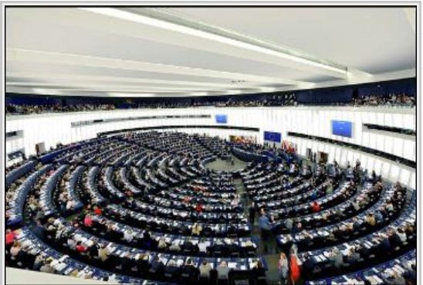
Fall 2022:
-Trilogues on RED III (Fit for 55) between representatives of the European Parliament, the Council and the European to reach a provisional agreement
-ITRE to adopt ist report and ENVI and AGRI their opinions on RED IV (REPowerEU)
December 2022:
-Plenary vote on RED IV
2023:
-Trilogues negotiations on RED IV
-Adoption of RED III + RED IV
The revision of the Renewable Energy Directive:
Next Steps
@European Parliament

Slide 22
THANK YOU
And have a nice summit!
For any further inquiries:
marilena.dauria@euronatur.org

