Slide 1
ATTENTION
Decision Makers!
Cornelia Wieser, Riverwatch

Slide 2
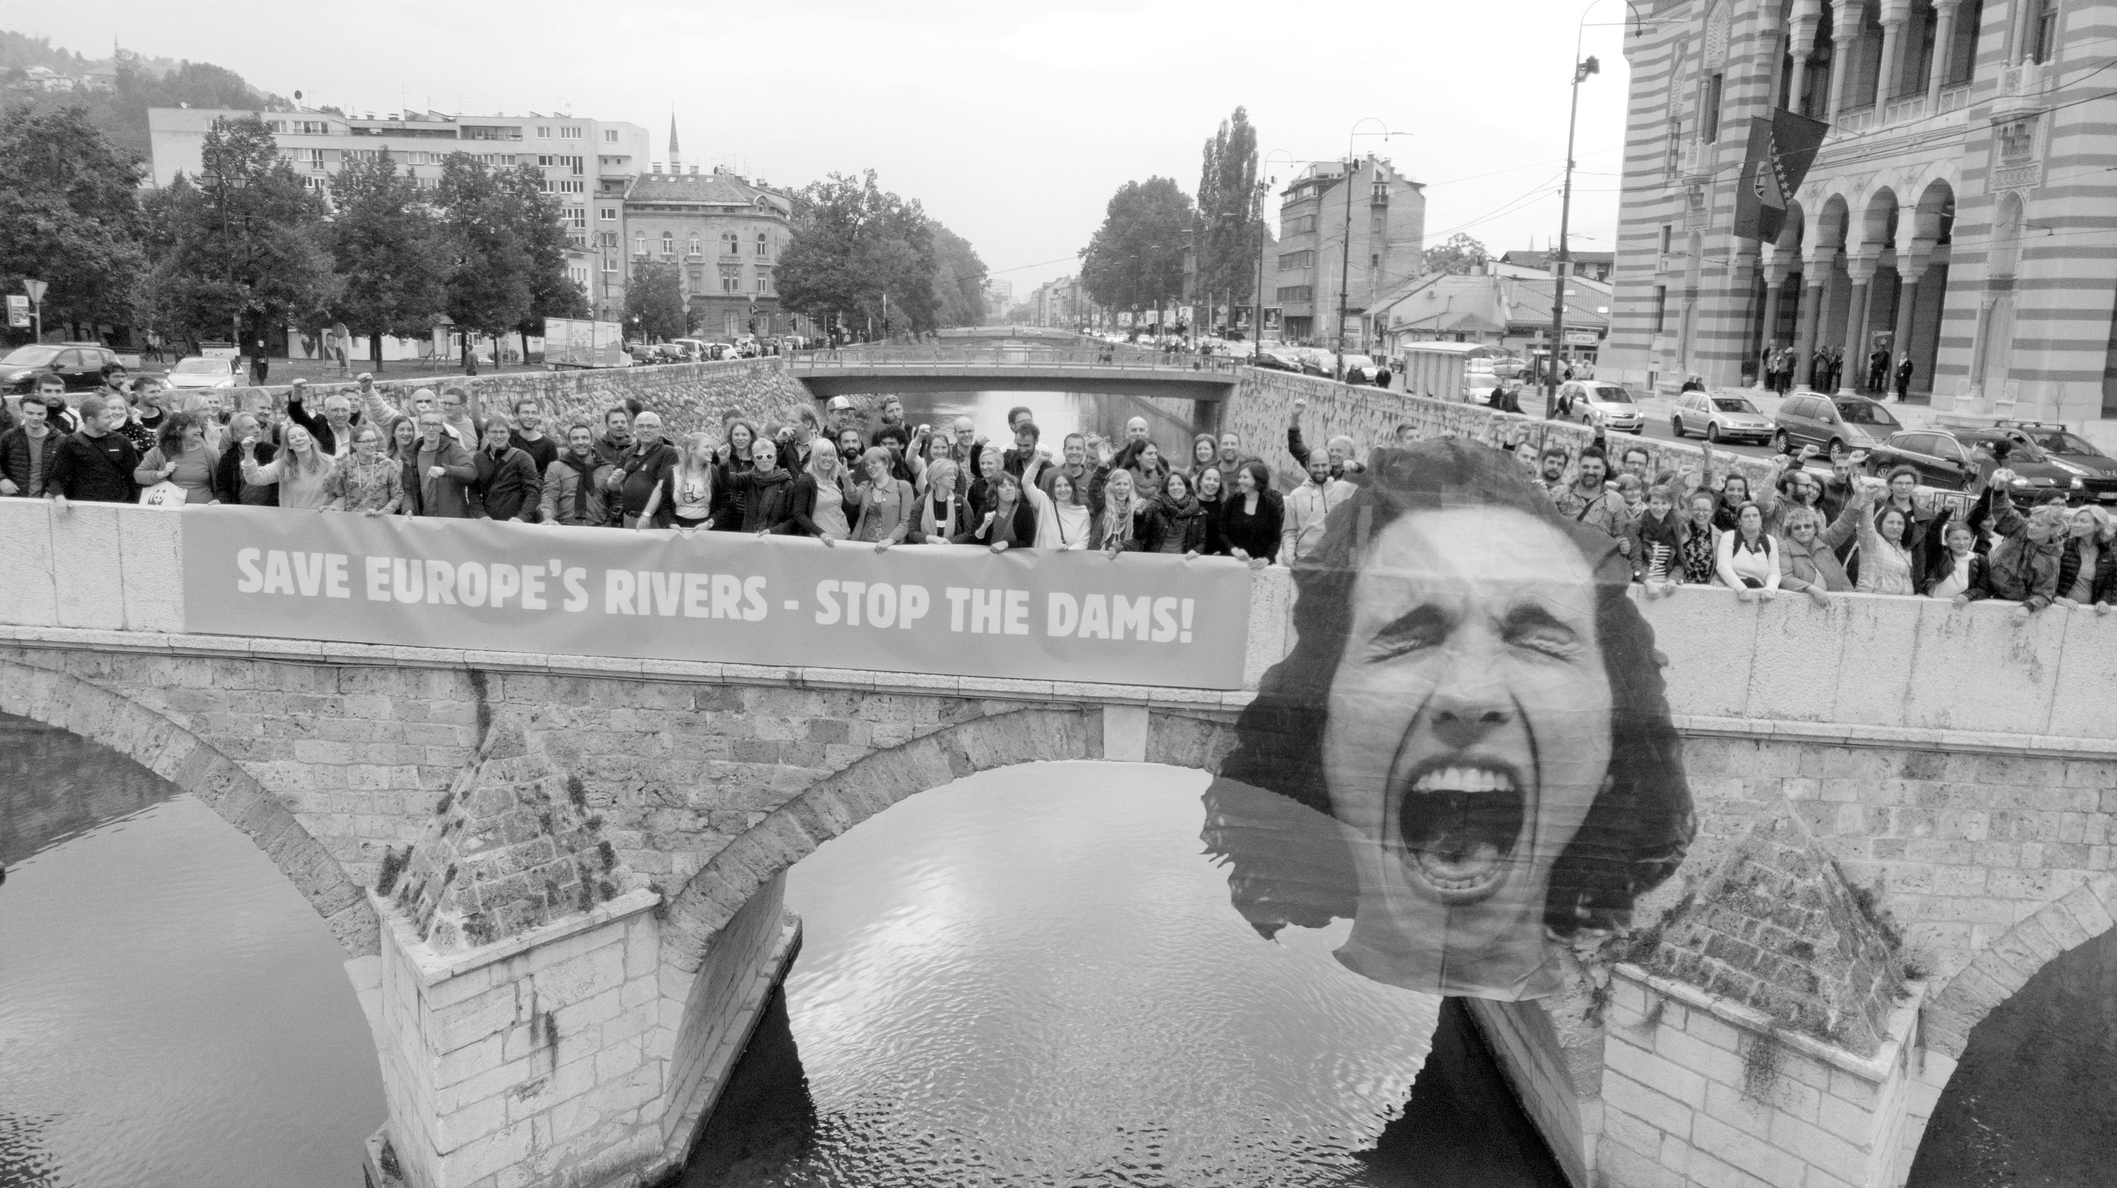
ATTENTION
Text
DECISION MAKERS!

Slide 4
Environment
Energy
YOUR DEMANDS
Human Rights
Accession

Slide 5
THANK YOU
And have a nice summit!

